Slide 1

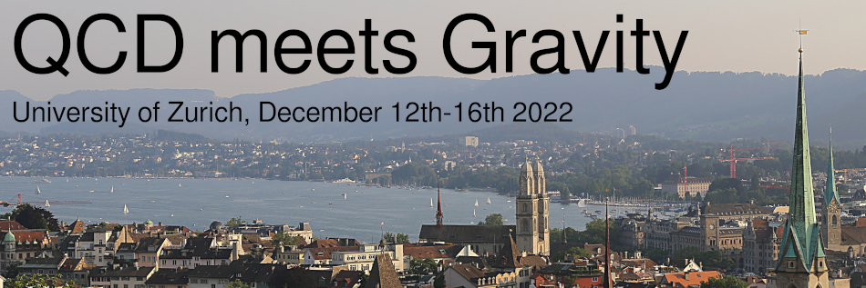
Extraction of high-order post-Minkowskian results from self-force calculations
Oliver Long
with L. Barack, Z. Bern, E. Herrmann, J. Parra-Martinez, R. Roiban, M. S. Ruf, C.-H. Shen, M. P. Solon, F. Teng, and M. Zeng.

Slide 2
Contents
Binary-black hole scattering modelling methods.
Motivation for extreme-mass ratio scattering.
Scattering geodesics.
Self-force contributions.
The scalar field toy model
Sample results:
  Comparison to current PM results.
  Probing higher-order PM terms.

Slide 3

Two-body parameter space for scattering
Separation
Numerical Relativity
Mass ratio

Slide 4

Two-body parameter space for scattering
Post-Minkowskian
expansion
Separation
Numerical Relativity
Mass ratio

Slide 5

Two-body parameter space for scattering
Post-Minkowskian
expansion
Separation
Perturbation theory
& Self-force
Numerical Relativity
Mass ratio

Slide 6

Two-body parameter space for scattering
Post-Minkowskian
expansion
Separation
Perturbation theory
& Self-force
Numerical Relativity
Mass ratio

Slide 7
Motivation: Extreme-mass ratio scatter orbits
Clean environment with well-defined asymptotic states.
Exact post-Minkowskian calculations for bound orbits [Damour ’19; Bini, Damour & Geralico ’20].

Slide 8
Motivation: Extreme-mass ratio scatter orbits
Clean environment with well-defined asymptotic states.
Exact post-Minkowskian calculations for bound orbits [Damour ’19; Bini, Damour & Geralico ’20].
Calibration of Effective-One-Body (EOB) in the ultra-strong field.
Notes:
Periastron as a func of impact parameter

Slide 9
Motivation: Extreme-mass ratio scatter orbits
Clean environment with well-defined asymptotic states.
Exact post-Minkowskian calculations for bound orbits [Damour ’19; Bini, Damour & Geralico ’20].
Calibration of Effective-One-Body (EOB) in the ultra-strong field.
Comparisons with scatter amplitude calculations:
  QFT and EFT [Bern et al. ‘21].
General Relativity
High-energy physics

Slide 10
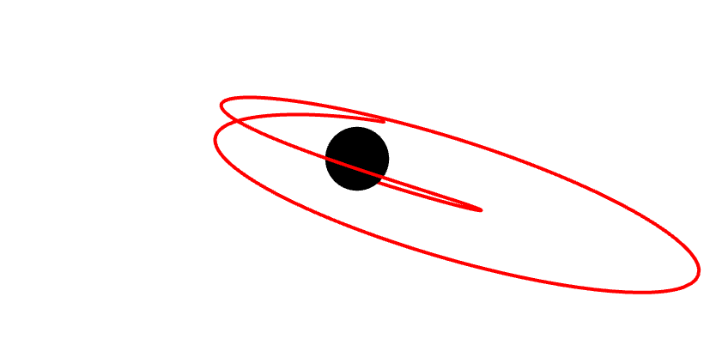
Motivation: Extreme-mass ratio scatter orbits
Clean environment with well-defined asymptotic states.
Exact post-Minkowskian calculations for bound orbits [Damour ’19; Bini, Damour & Geralico ’20].
Calibration of Effective-One-Body (EOB) in the ultra-strong field.
Comparisons with scatter amplitude calculations:
  QFT and EFT [Bern et al. ‘21].
Dictionary between scatter and bound [Cho et al. ‘21].
  Scattering angle ↔︎ periastron advance.
Scattering
Bound

Slide 11
Scattering geodesics
Energy and angular momentum:

Slide 12
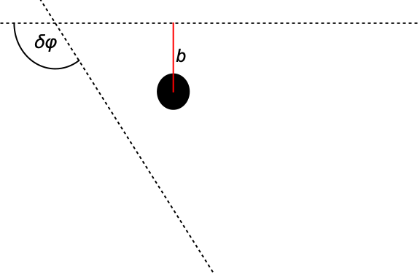
Scattering geodesics
Energy and angular momentum:
Geodesics:
Scattering angle:
Velocity at infinity and impact parameter:

Slide 13
Self-forced equations of motion
Expansion in the mass ratio:
Perturbed equations of motion:
Can split self-force into conservative and dissipative pieces:
Dissipative self-force removes energy and angular momentum from the system.
Schwarzschild/Kerr
Geodesic

Slide 14
Self-force correction to the scattering angle
Scattering angle as a radial integral:
Perturb equation [Barack & OL ‘22]:
Can split into conservative and dissipative pieces on outgoing leg:
Notes:
1/r factor increases difficulty as singularity at periastron

Slide 15
Scalar self-force model
Endow particle with a spin-0 scalar charge q.
New small parameter:
Scalar field obeys the Klein-Gordon equation:
Scalar self-force:

Slide 16
Scalar self-force in terms of amplitudes
Lagrangian:
Three-point interaction vertices:
Only keep terms which are linear in mass-ratio and proportional to
[Cheung, Rothstein, Solon]
[Bern, Cheung, Roiban, Shen, Solon, Zeng]
[Bern, Cheung, Para-Martinez, Roiban, Ruf, Shen, Solon, Zeng]
Notes:
Bottom diagrams representative
2PM: [Cheung, Rothstein, Solon]
3PM: [Bern, Cheung, Roiban, Shen, Solon, Zeng]
4PM: [Bern, Cheung, Para-Martinez, Roiban, Ruf, Shen, Solon, Zeng]

Slide 17
Scattering angle correction: PM expansion
2PM [Gralla & Lobo ‘22]:
3PM:
4PM dissipative:

Slide 18
Scalar field evolution scheme
Worldline
Decompose scalar field in the time-domain:
1+1D scalar wave equation in null-coordinates:
Evolve finite-difference version of 1+1D equation.
Initial conditions
Notes:
Extract SF via mode-sum regularisation

Slide 19
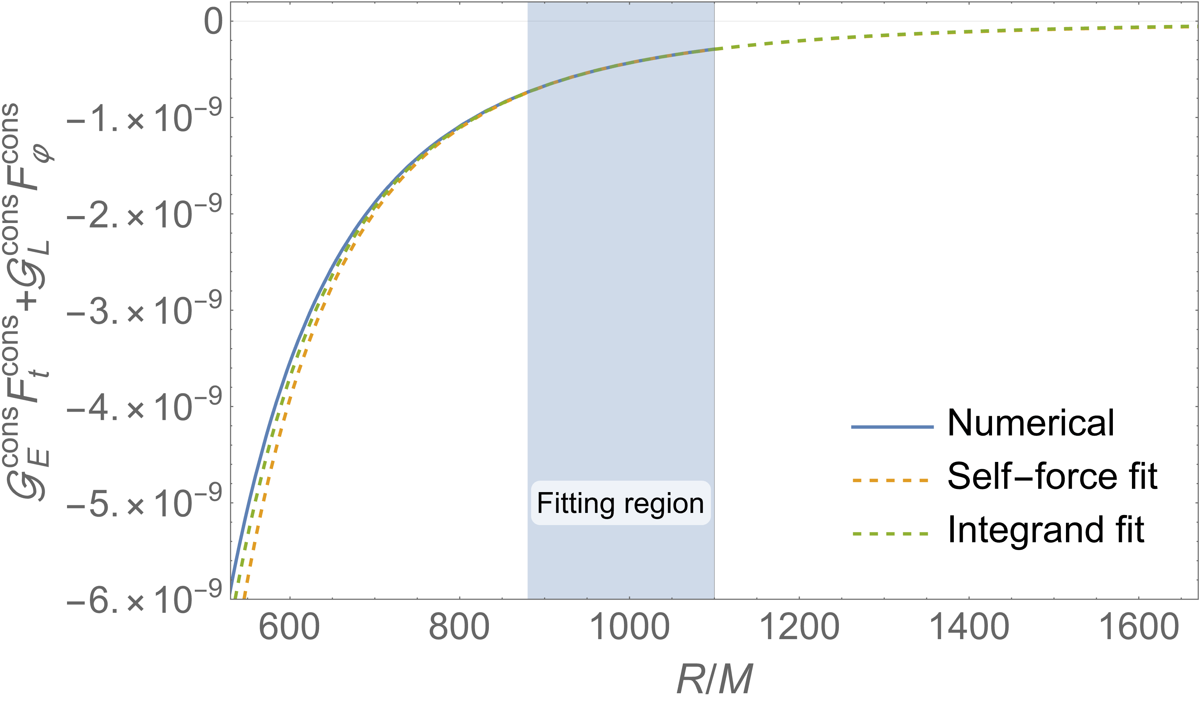
Post-processing: Truncation at finite radius
Can only numerically determine the self-force up to a finite radius
Form an analytic tail by fitting to the data:
  Fit the self-force data.
  Fit the integrand directly.
Tail contributes an error ~ 0.01%.
Numerical
Error (~1%)

Slide 20
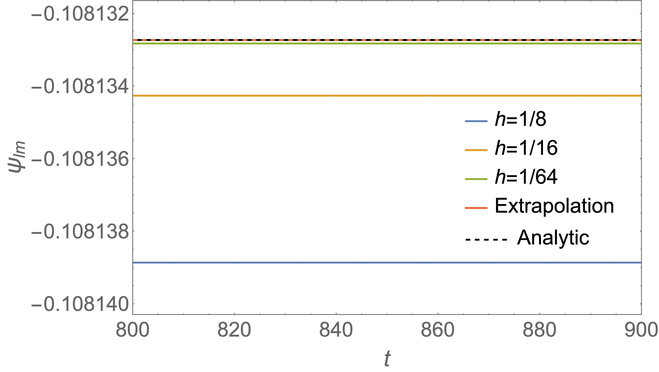
Post-processing: Richardson extrapolation
Next dominant error due to finite resolution ~ 0.1%.
Can increase the convergence from quadratic to cubic using Richardson extrapolation.
Model:
Extrapolation:
Error in extrapolation < 0.001%.

Slide 21
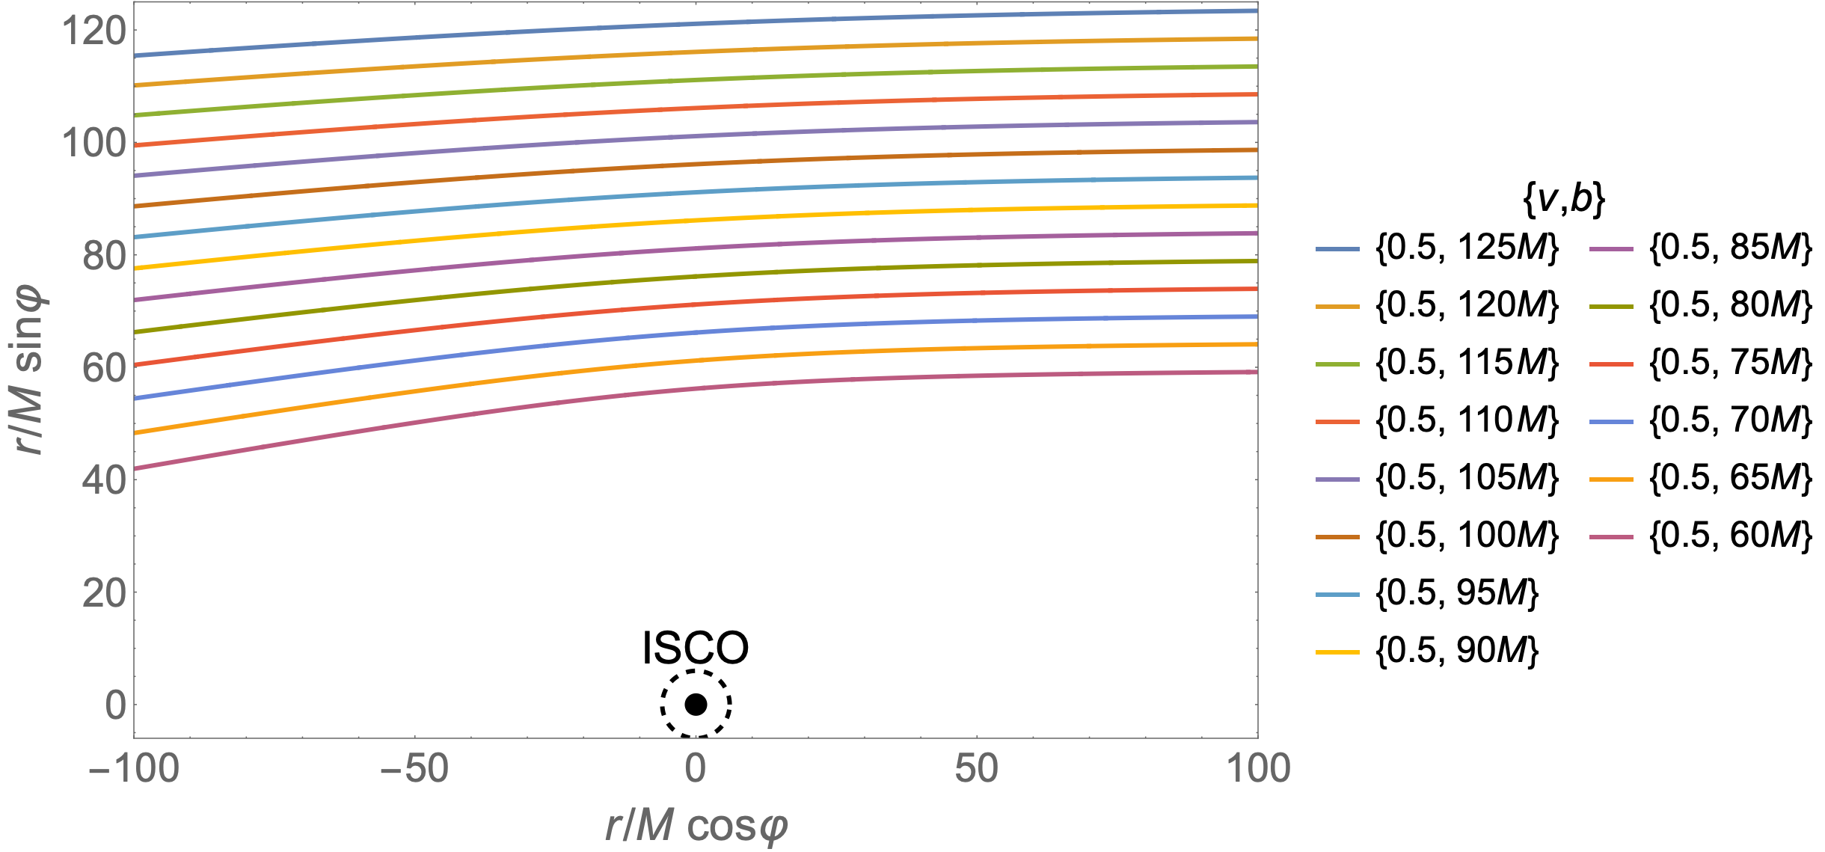
Sample orbits

Slide 22
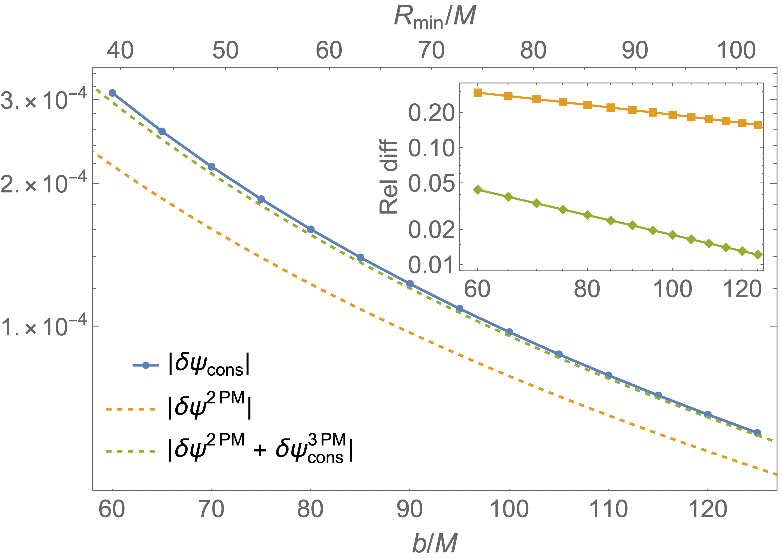
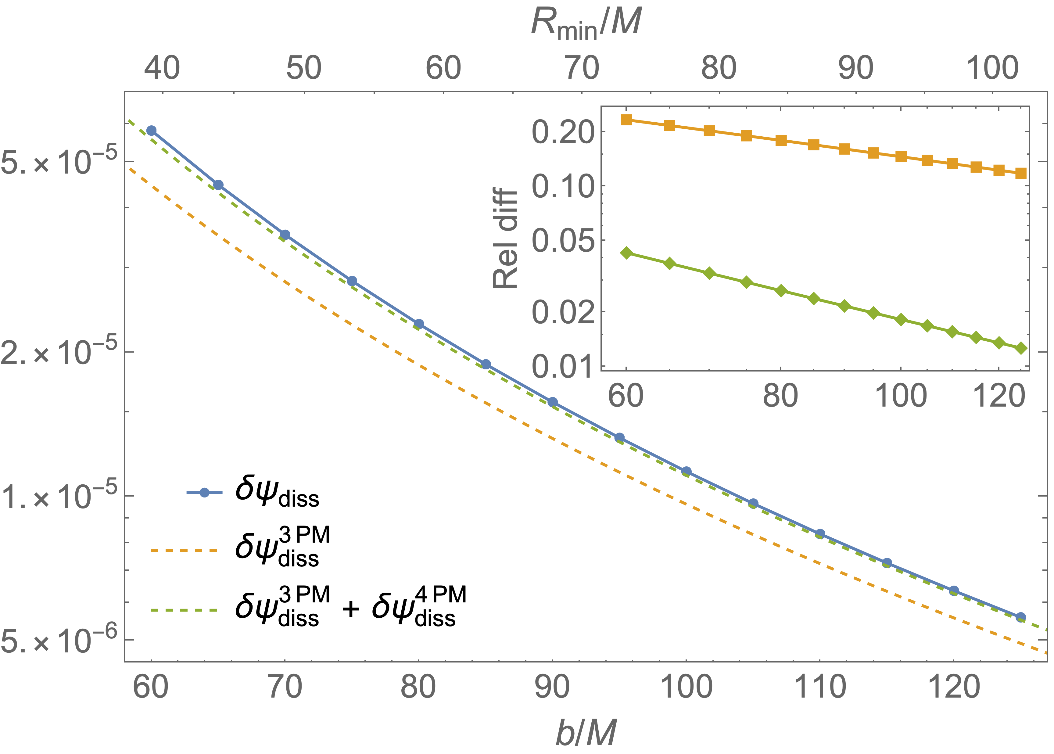
PM comparison:
Conservative
Dissipative

Slide 23
Scattering angle correction: 4PM conservative
Elliptic integrals
Free coefficients
Log term
Preliminary

Slide 24
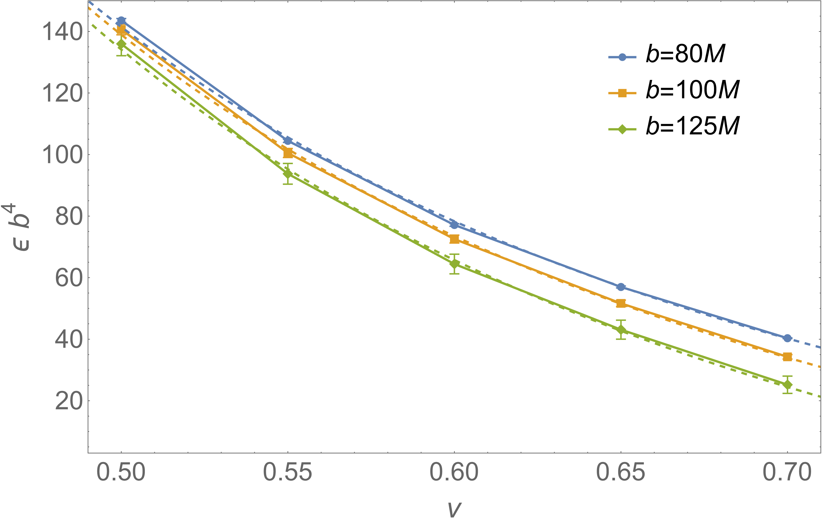
Extraction of high-order conservative PM results
Subtract known analytic parts:
80 | -202.6 ± 1.7 | 20.07 ± 0.09
100 | -96.8 ± 2.7 | 8.52 ± 0.13
125 | -114 ± 8 | 8.91 ± 0.35
Preliminary

Slide 25
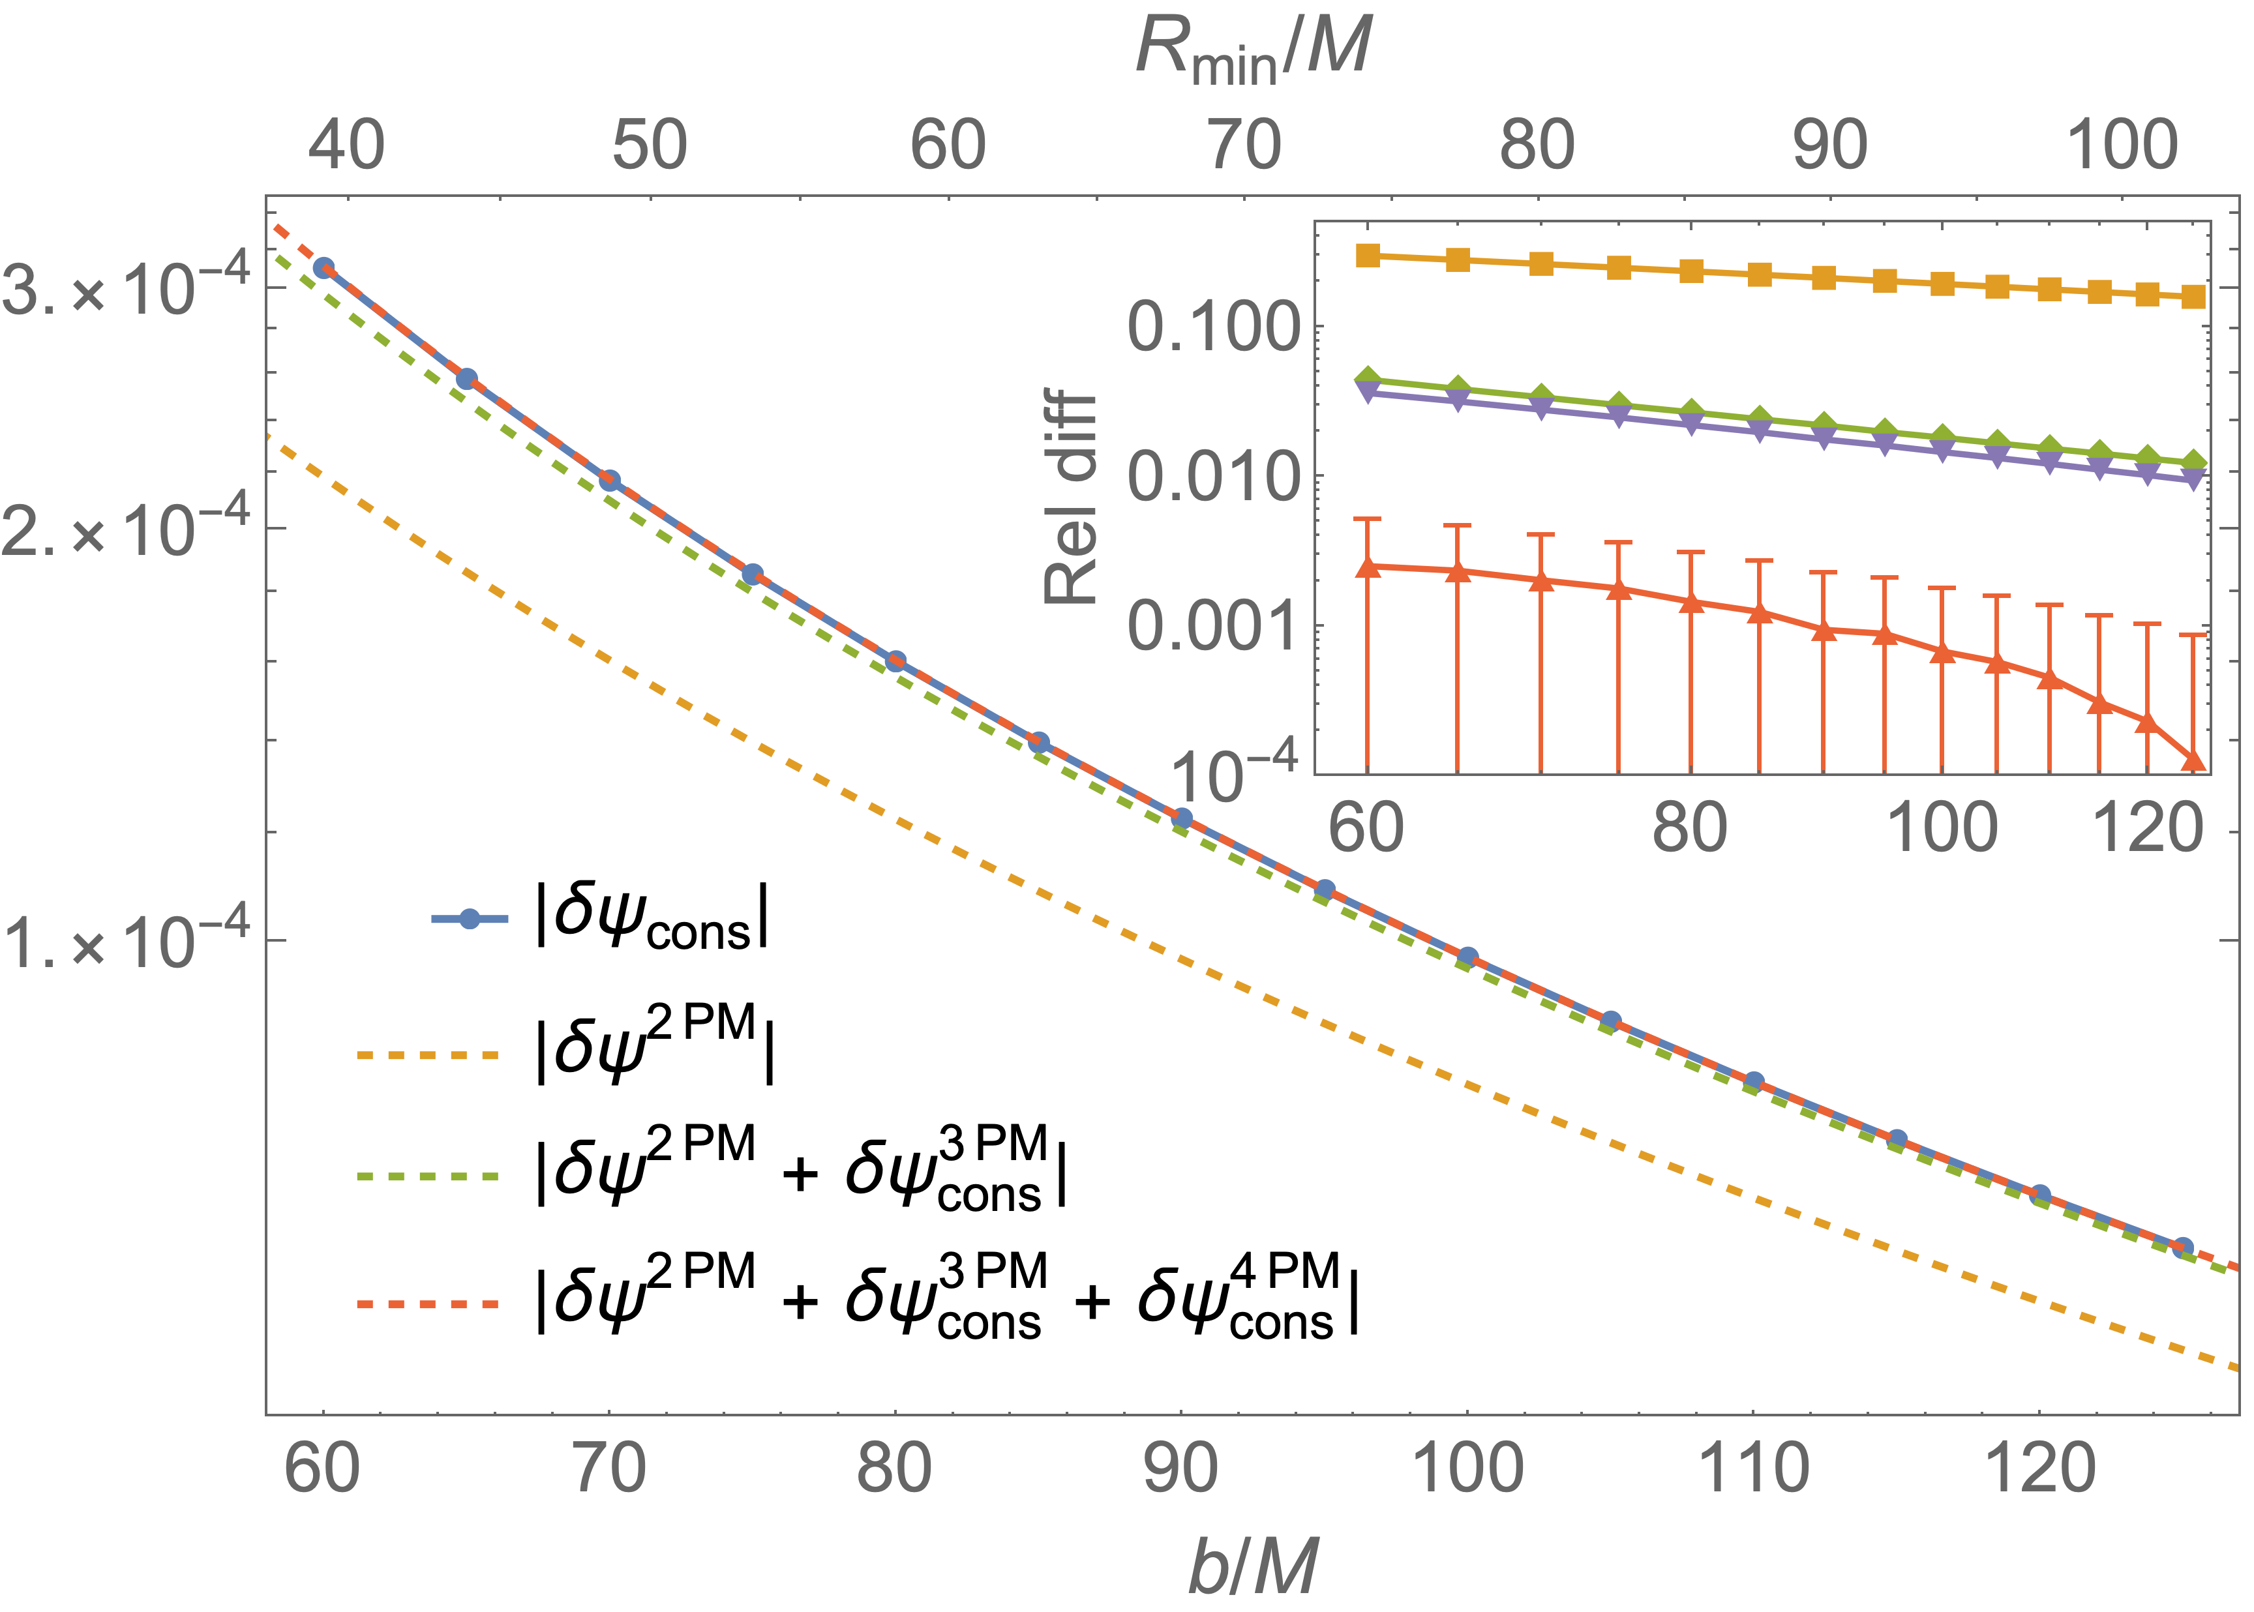
PM comparison: Conservative
Preliminary

Slide 26
Extraction of high-order dissipative PM results
PM expansion with free parameters:
Up to 4PM can fit value or use analytic value.
11.2 ± 0.1
9.439 ± 0.01 | 184 ± 1
9.632 ± 0.002 | 143.8 ± 0.4 | 1847 ± 17
9.593 ± 0.002 | 152.7 ± 0.3 | 990 ± 31 | 25900 ± 900
9.6225 | 166.7 ± 1.3
9.6225 | 146.82 ± 0.09 | 1707 ± 7
9.6225 | 148.0 ± 0.02 | 1476 ± 34 | -62100 ± 8700
9.6225 | 143.344 | 1987 ± 17
9.6225 | 143.344 | 2372 ± 29 | -25500 ± 2100
Preliminary

Slide 27
Summary and future work
Compared numerical scalar self-force results with analytic PM results.
Good agreement for both conservative and dissipative:
  ~10% for LO.
  ~ 1% for NLO.
Have investigated extractions of higher-order components from numerics:
  Fixed free parameters in 4PM conservative: agreement with numerics to < 0.5%.
  Extraction of 5PM dissipative coefficient.
Future work:
  Calculate the gravitational self-force correction to the scattering angle.
  Compare to PM(/NR/EOB) in the gravitational case.
Contact: oliver.long@aei.mpg.de

