Slide 1
Towards a Universal Decomposition of Phase-Space Integrands
David A. Kosower
Institut de Physique Théorique, CEA–Saclay
work with Ben Page (CERN), [2211.14156]
QCD Meets Gravity 2022
in Zurich— Dec 15, 2022

Slide 2
Taming Jets’ Hair
Jet differential cross sections are the finest-grained observables at modern colliders
LO — each jet modeled by a lone parton
NLO — virtual: same; IR divergences in loop integrals
— real-emission, some jets modeled by pair,
IR divergences in phase-space integrals
NNLO — double-virtual: lone parton, IR divs in loop integrals
— mixed: mixed divergences
— double-real: IR divergences in phase-space integrals
Need to cancel divergences
Ideally point-by-point in jet phase space

Slide 3
Current Approaches
Cancel in physical observables (not point by point)
Slicing — virtual divergences known analytically
— separate singular regions (soft, collinear)
— integrate analytically
— integrate numerically in hard regions
Giele & Glover; Giele, Glover, & DAK
Subtraction — singular behavior known analytically
— subtract it everywhere, resulting integral finite
— integrate singular functions analytically
Catani & Seymour; Frixione, Kunszt, & Signer; Nagy & Soper;
Bevilacqua, Czakon, Kubocz, & Worek
NNLO — generalizations of subtraction
Gehrmann-De Ridder, Gehrmann, & Glover; Weinzierl;
Del Duca, Duhr, Kardos, Somogyi, Szőr, Trócsányi, & Tulipánt; Czakon;
Magnea, Maina, Pelliccioli, Signorile-Signorile, Torrielli, & Uccirati
— hybrid schemes
Stewart, Tackmann, & Waalewijn; Catani & Grazzini
Complicated and not yet fully general

Slide 4
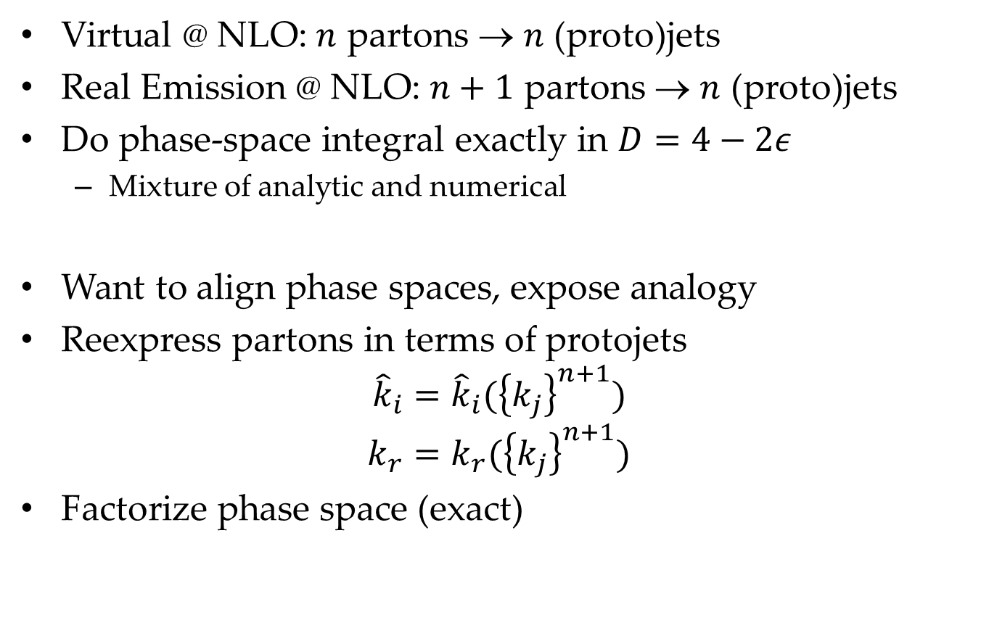
Framework
Virtual @ NLO: $n$ partons → $n$ (proto)jets
Real Emission @ NLO: $n+1$ partons → $n$ (proto)jets
Do phase-space integral exactly in $D=4−2ε$
  Mixture of analytic and numerical
Want to align phase spaces, expose analogy
Reexpress partons in terms of protojets
$${\hat{k}}_{i}={\hat{k}}_{i}({\left\{k_{j}\right\}}^{n+1})$$
$$k_{r}=k_{r}({\left\{k_{j}\right\}}^{n+1})$$
Factorize phase space (exact)

Slide 5
Vision of the Destination
If you don't know where you're going, you'll end up someplace else. —Yogi Berra
Master-integral decomposition of multi-emission phase-space integrals
⇑
Master-integral decomposition of single-emission phase-space integrals
⇑
Decomposition of single-emission phase-space integrands: squares of tree amplitudes
⇑

Slide 6
A thousand-mile journey begins with a single step
Paraphrase of Laozi (between 2300 – 2500 yrs ago)
Decomposition of tree amplitudes with one emission
Suitable mapping to isolate emission
~ “theoretical” jet algorithm
Classification of amplitudes
Computational algebraic geometry

Slide 7
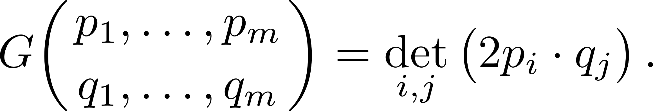

Decomposition of One-Loop Integrands
First: integrands with trivial numerators
Integrand of hexagon
External momenta strictly in $D=4$
Use Gram determinants

Slide 8
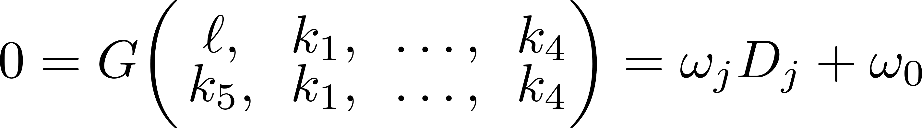
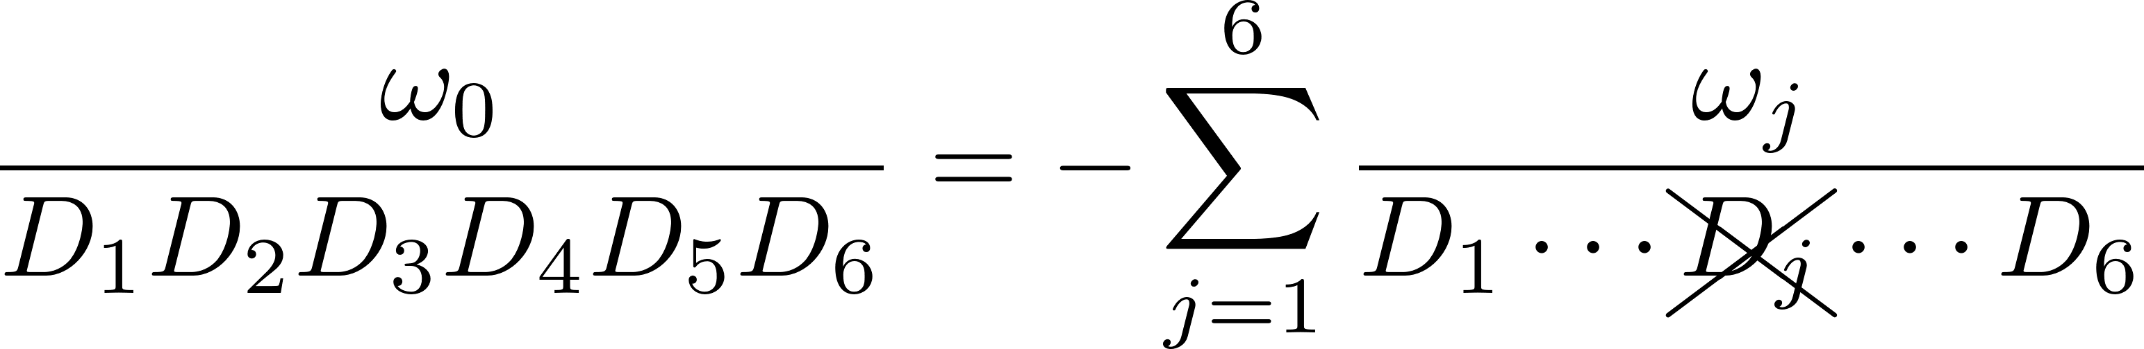

Scalar Hexagon Decomposition
Six denominators $D_{j}={\left(ℓ−K_{1,j}\right)}^{2}$
Write a Gram identity
And put it over the denominator

Slide 9
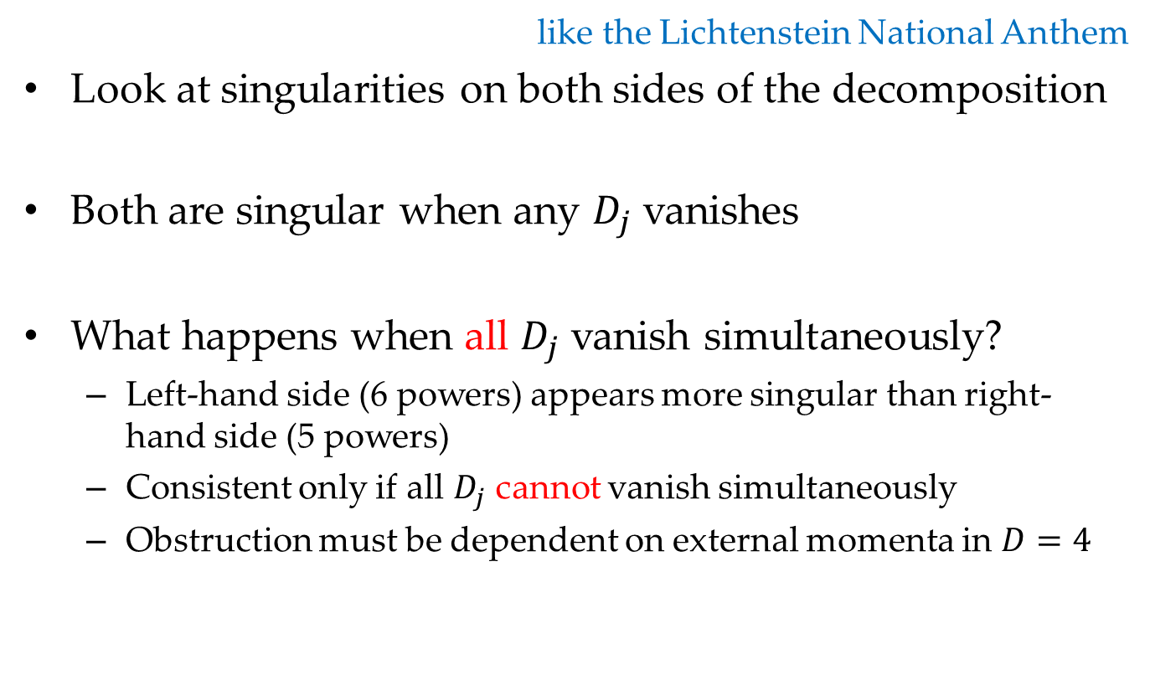
New Lyrics to an Old Melody
like the Lichtenstein National Anthem
Look at singularities on both sides of the decomposition
Both are singular when any $D_{j}$ vanishes
What happens when all $D_{j}$ vanish simultaneously?
  Left-hand side (6 powers) appears more singular than right-hand side (5 powers)
  Consistent only if all $D_{j}$ cannot vanish simultaneously
  Obstruction must be dependent on external momenta in $D=4$

Slide 10
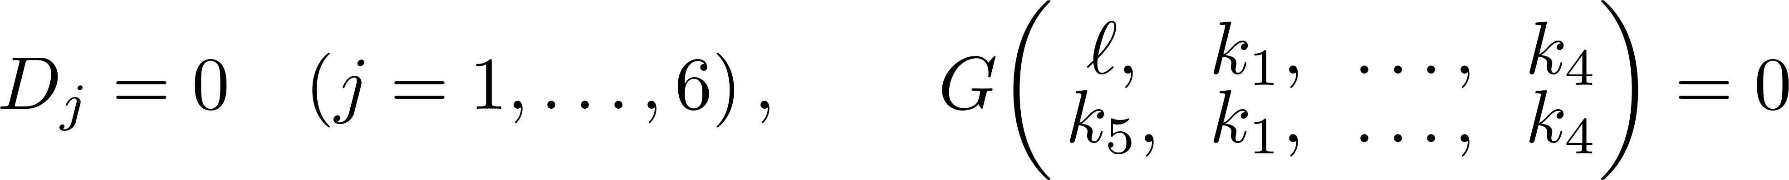
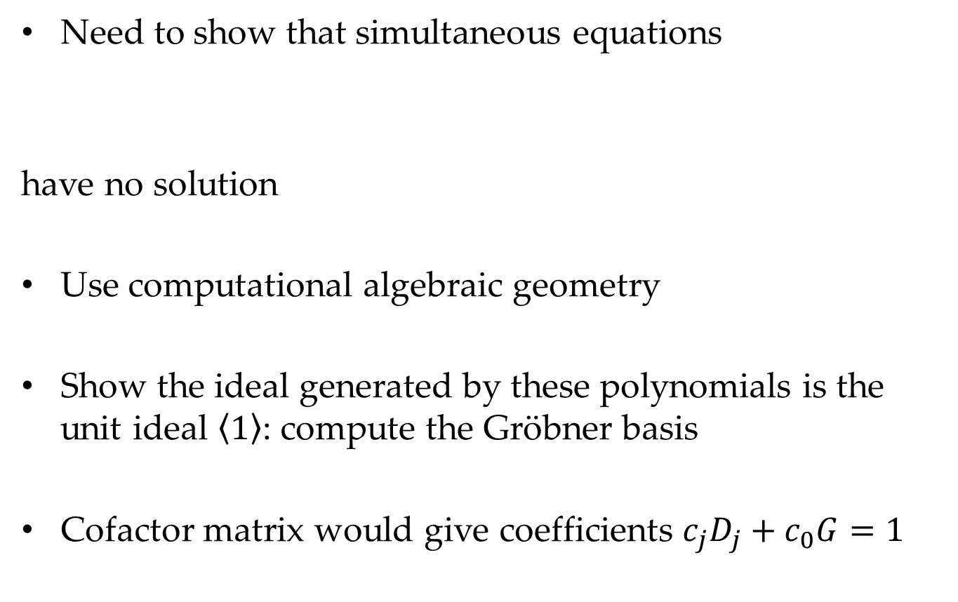
Inconsistency of Equations
Need to show that simultaneous equations
have no solution
Use computational algebraic geometry
Show the ideal generated by these polynomials is the unit ideal $\left\langle 1\right\rangle$: compute the Gröbner basis
Cofactor matrix would give coefficients $c_{j}D_{j}+c_{0}G=1$

Slide 11
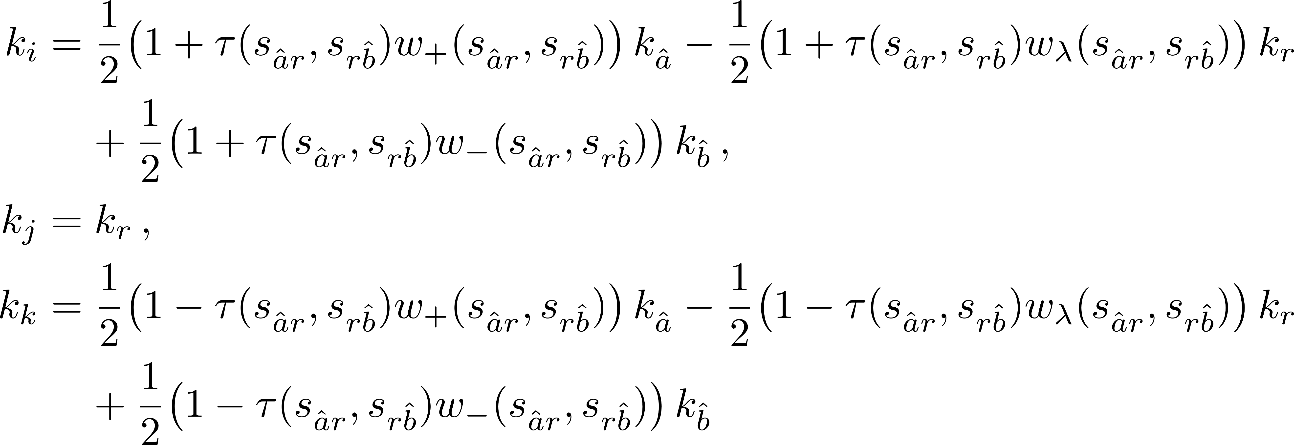

Inverse Antenna Mapping
Antenna mapping: maps partons → protojets
Three recombining momenta yielding two massless protojets
Want to map protojets → partons, so that we can write
  original partons as f(protojets, real emission)
Ultimately, functions of $τ, \hat{λ}, s_{\hat{a}r},s_{r\hat{b}},s_{r1}, s_{r2}$

Slide 12
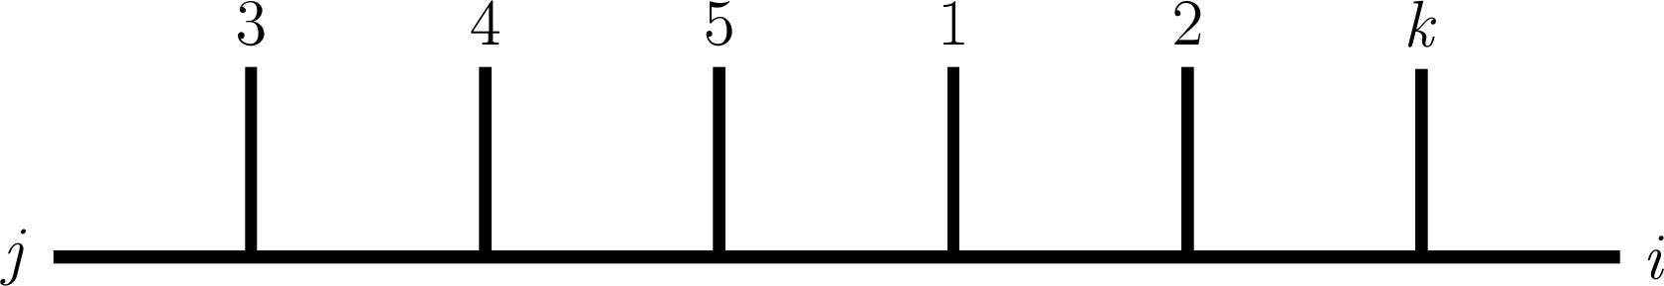
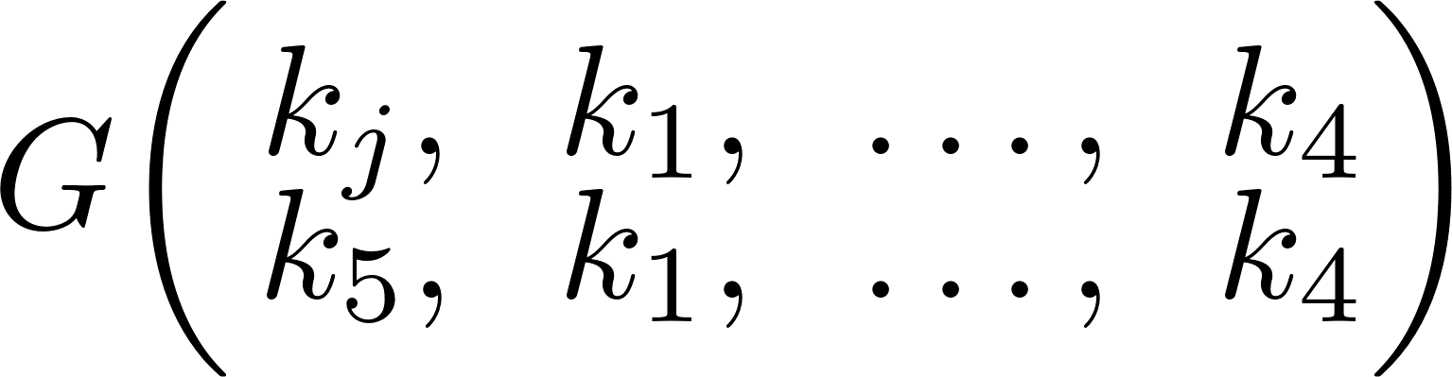
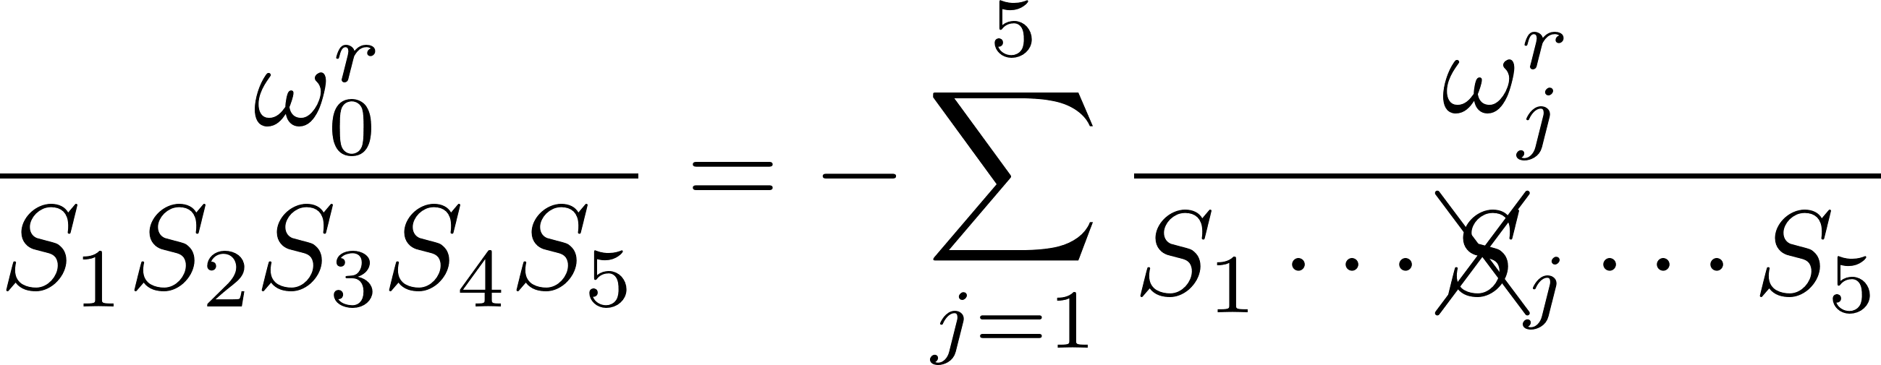

Simple Example
Contribution $\frac{1}{s_{j3}s_{j34}s_{j345}s_{j1345}s_{j12345}}$
$S_{1}=s_{j3}, S_{2}=s_{j34}, S_{3}=s_{j345}, S_{4}=s_{j1345}, S_{5}=s_{j12345}$
Build a Gram
It gives a similar decomposition

Slide 13
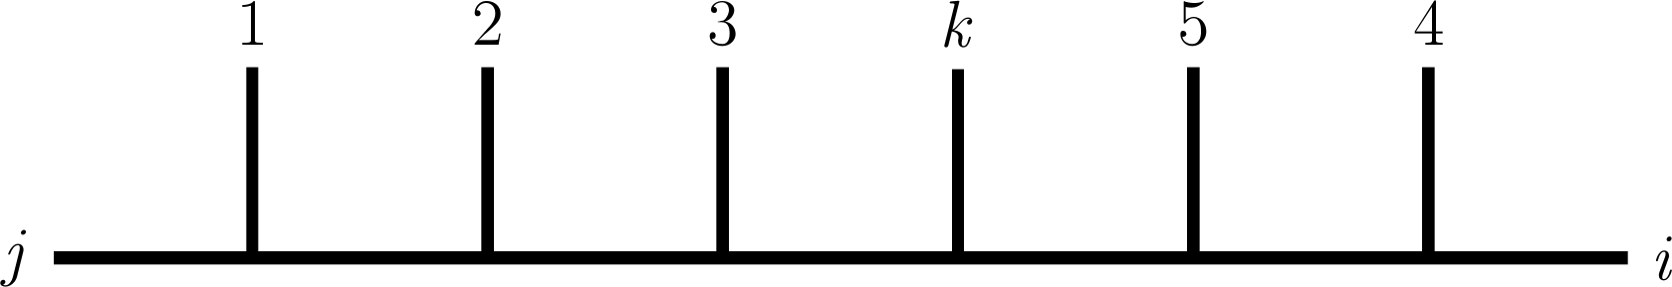
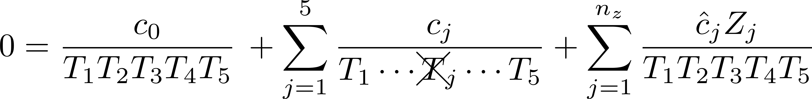
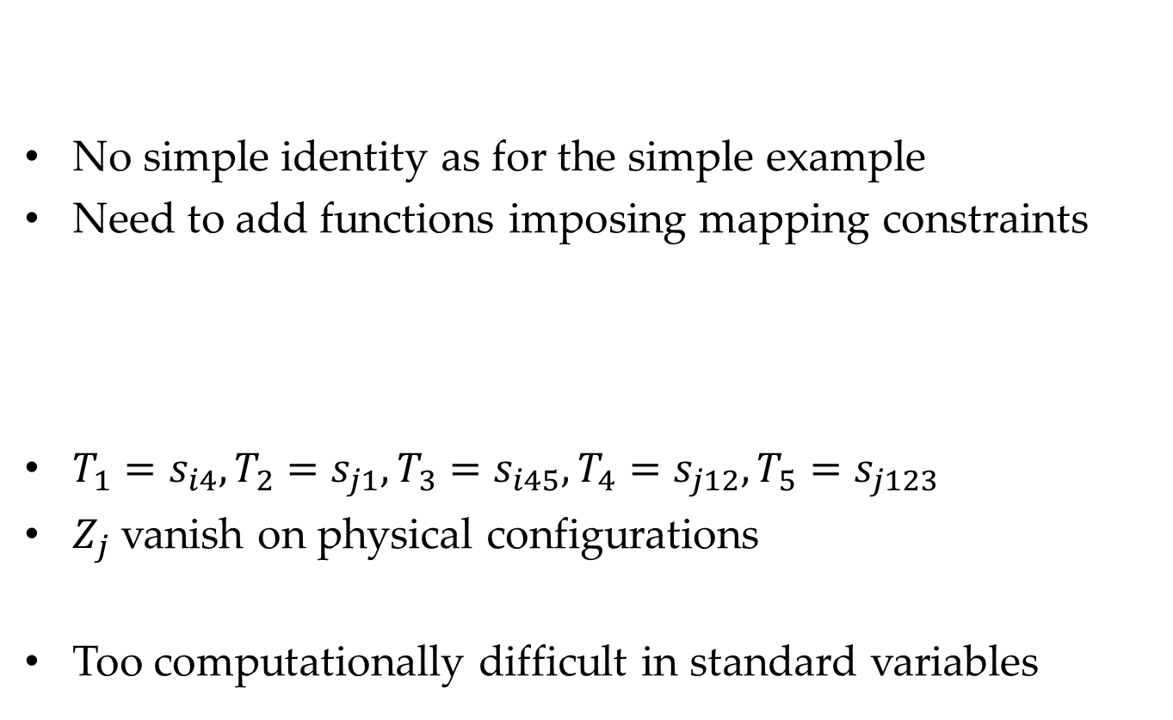
Harder Case
No simple identity as for the simple example
Need to add functions imposing mapping constraints
$T_{1}=s_{i4}, T_{2}=s_{j1}, T_{3}=s_{i45}, T_{4}=s_{j12}, T_{5}=s_{j123}$
$Z_{j}$ vanish on physical configurations
Too computationally difficult in standard variables

Slide 14
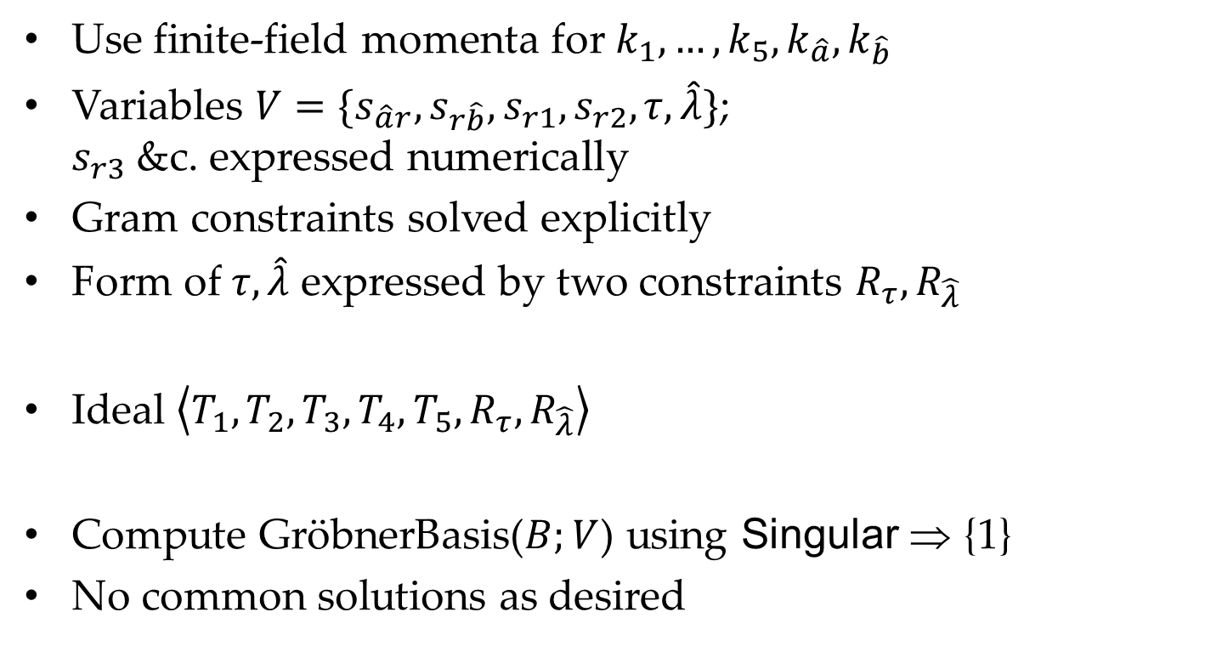
Better Variables & Finite Field Numerics
Use finite-field momenta for $k_{1},…,k_{5},k_{\hat{a}},k_{\hat{b}}$
Variables ${V=\{s}_{\hat{a}r},s_{r\hat{b}},s_{r1}, s_{r2}, τ, \hat{λ}\}$;
$s_{r3}$ &c. expressed numerically
Gram constraints solved explicitly
Form of $τ, \hat{λ}$ expressed by two constraints $R_{τ}, R_{\hat{λ}}$
Ideal $\left\langle T_{1},T_{2},T_{3},T_{4},T_{5},R_{τ},R_{\hat{λ}}\right\rangle$
Compute GröbnerBasis($B;V$) using Singular ⇒ {1}
No common solutions as desired

Slide 15
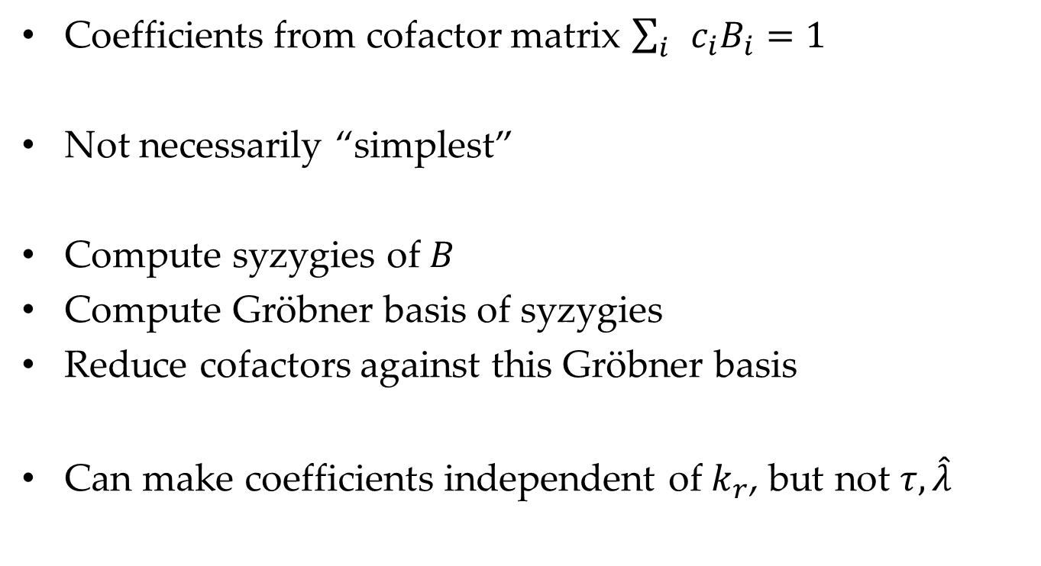
Coefficient Simplification
Coefficients from cofactor matrix $\sum_{i}{c_{i}B_{i}=1}$
Not necessarily “simplest”
Compute syzygies of $B$
Compute Gröbner basis of syzygies
Reduce cofactors against this Gröbner basis
Can make coefficients independent of $k_{r}$, but not $τ,\hat{λ}$

Slide 16

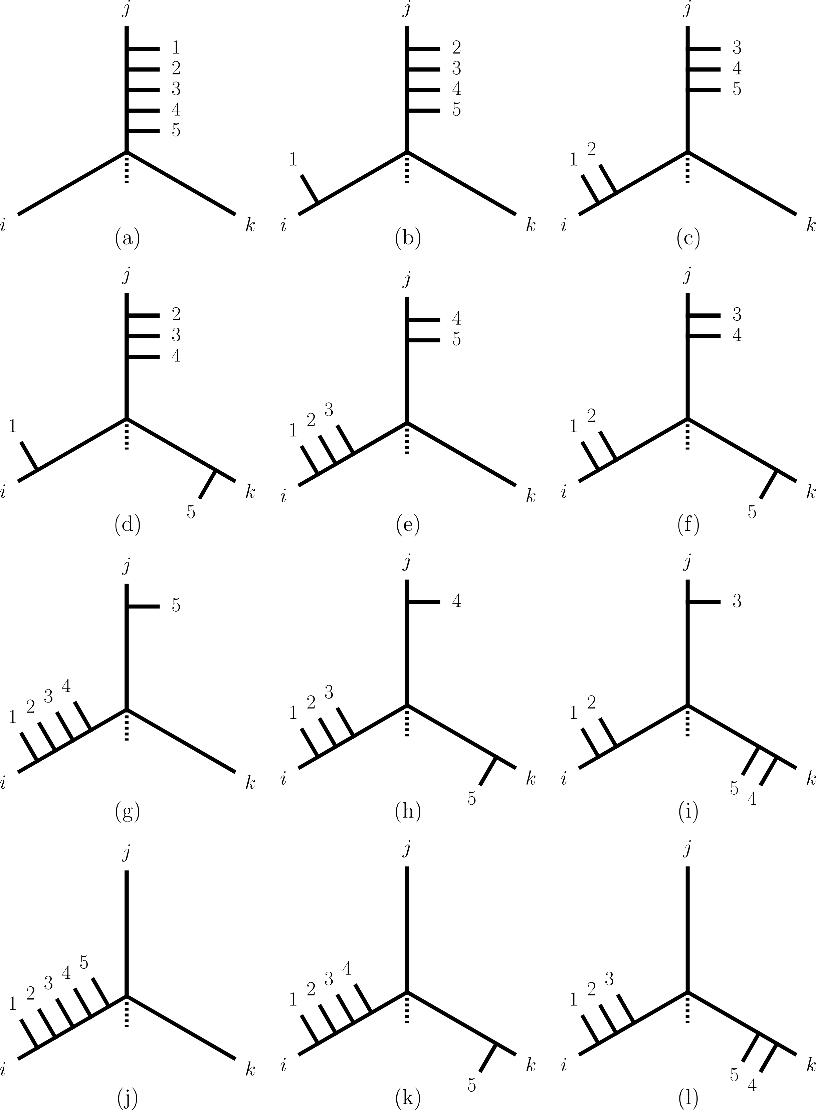
Triskelia
a well-known triskelion
Classify all possible contributions:
focus on all possible arrangements
of the three recombining partons
Lines from each inwards will
ultimately meet at a center
Number and types of legs attached
give different triskelia
Twelve major classes, subclasses
depending on masses

Slide 17

Survey
Consider 1152 triskelia (after symmetries)
All yield unit Gröbner basis
In all cases, coefficients can be made independent of $k_{r}$
Results independent of external masses

Slide 18
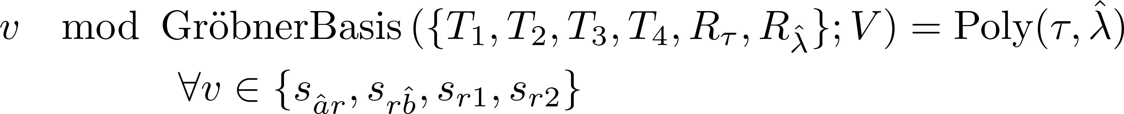
Numerators
What about reduction of nontrivial numerators?
In one-loop integrals, just ordinary partial fractioning
In CAG,
Analog for tree-level contributions

Slide 19
Summary
First step towards decomposing phase-space integrals into master integrals
Recast one-loop integral reduction into language of computational algebraic geometry
Generalizes to allow partial-fractioning of any cubic contribution to a tree-level scattering amplitude
Finite basis of master integrals

