Slide 1
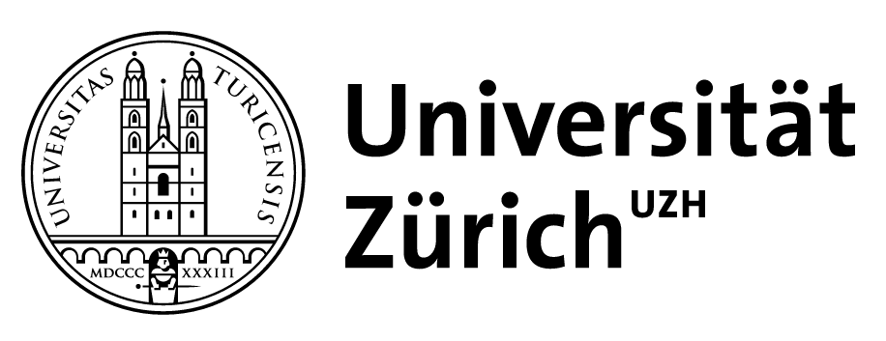

Celestial Twistor Amplitudes
Joshua Gowdy
Queen Mary University of London
QCD Meets Gravity ‘22
University of Zurich
Based on 2212.01327 with Graham Brown and Bill Spence

Slide 2
Goal and Methodology
To study light transformed celestial correlators
  Free of delta function singularities from bulk momentum conservation
  Possibly candidate for THE basis celestial holographic states
  Extract CCFT data
By studying celestial twistor amplitudes
  Precise twistor/light correspondence
  Twistor amplitudes have already been computed
  Mellin transforms are easy-ish!
Sharma 2107.06250
Jorge-Diaz, Pasterski, Sharma
2212.00962
De, Hu, Srikant, Volovich
2206.08875
Notes:
Our contribution will be to pioneer a new way of studying these correlators via celestial twistor amplitudes. This will lead to nice compact formulae and a more amplitudesy perspective.
Ambidextrous here means we are free to use either light or dual light bases for each leg of the amplitude independently, often this will be done according to the helicity of the leg particle.
Ambidextrous here means we are free to use either light or dual light bases for each leg of the amplitude independently, often this will be done according to the helicity of the leg particle.

Slide 3
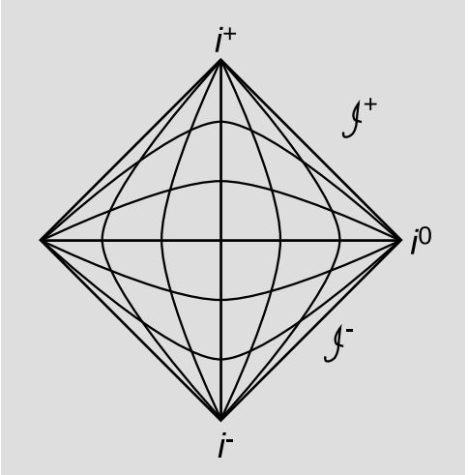
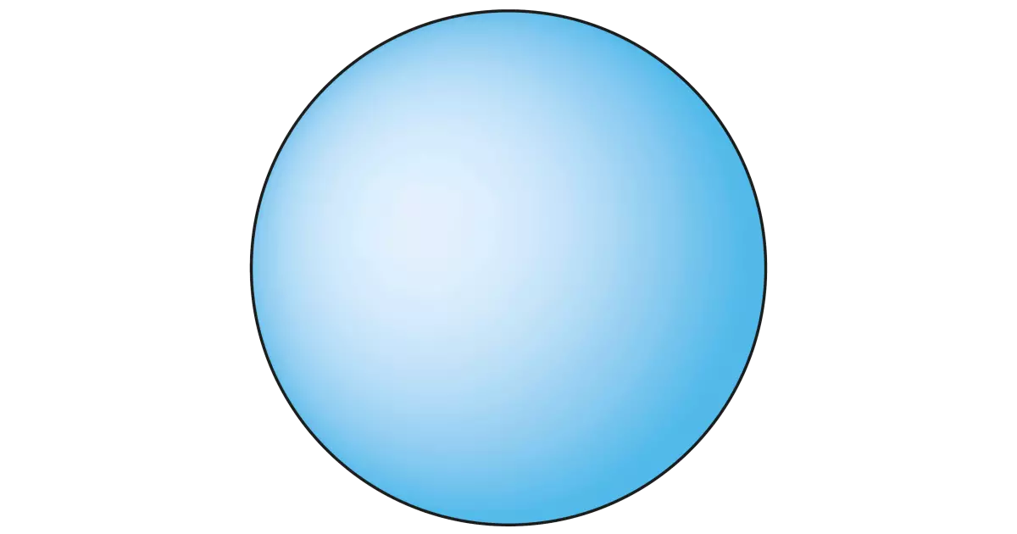

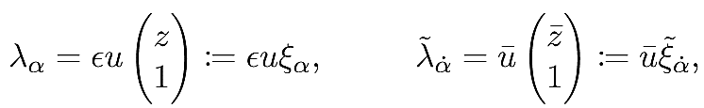

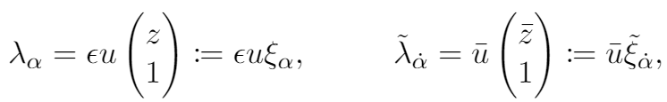
Lorentzian Scattering (Warm Up)
States are incoming or outgoing and are defined at two components of null infinity
Celestial Sphere
Notes:
We will avoid using these coordinates entirely and this will lead to some conceptual and practical benefits

Slide 4
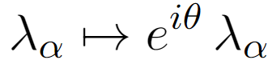
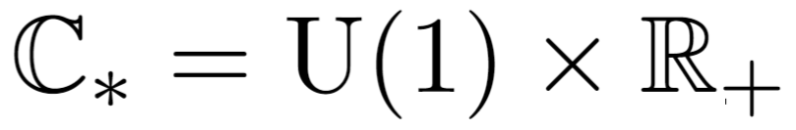
Describing an Amplitude (Warm Up)
Scattering amplitudes of massless particles are functions of spinors.
Spinors act as homogeneous coordinates on the null cone.
Little group action
States/amplitudes are homogeneous functions labelled by representations of , namely helicity J.
Notes:
Lambda tilde is complex conjugate to lambda for outgoing states, but is minus complex conjugate for incoming.
Completely general story, whenever we quotient a space by a group action, functions on that space are labelled by representations of the group. Discrete label for compact group, continuous for non compact.

Slide 5
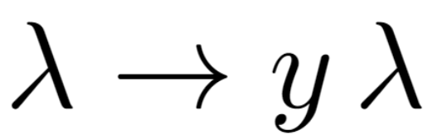
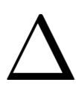
Describing a Celestial Amplitude
Celestial amplitudes of massless particles are also functions of spinors.
Spinors act as homogeneous coordinates on the celestial sphere.
Extended Little group action
Celestial states/amplitudes are homogeneous functions labelled by representations of namely conformal dimension and helicity J
Banerjee, 1801.10171
Notes:
So I would like to approach celestial holography from and amplitudologist perspective and describe celestial amplitudes using a similar language to scattering amplitudes, after all they are the same physical object just in a different basis a boost eigen basis. Continue using homogeneous coordinates.
Introduce the concept of extended little group first used by Banerjee in … it captures the fact that conformal primaries are also covariant under rescalings of the momenta.
Quotient by positive rescalings to get two copies of the celestial sphere coordinates z and epsilon. In 1,3 Lorentz boosts cannot change sign of momenta so can define lorentz invariant notion of future and past pointing vectors and incoming and outgoing states.

Slide 6
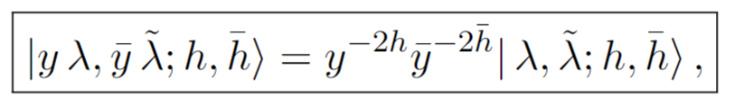

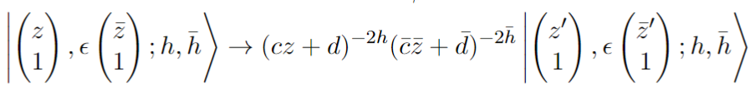
4d Lorentz = 2d Conformal
Only ever need to check these!
Homogeneity property
Plus Lorentz action
Implies 2d conformal covariance in affine coordinates
Notes:
This is a spinorial embedding space formalism for the 2d, in this case Euclidean, CFT.

Slide 7
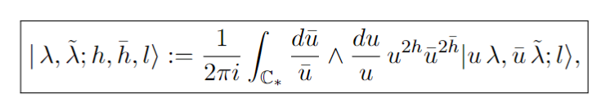

Chiral Mellin Transform
In general, to build such states/amplitudes in homogeneous coordinates we use a chiral Mellin transform given by
The spin condition appears naturally
Brandhuber, JG, Brown, Spence, Travaglini 2105.10263
Gelfand et al. Generalized Functions, Volume 5
Notes:
We introduced this chiral Mellin transform to correctly deal with spinors in celestial holography which was crucial for studying supersymmetry on the celestial sphere and deriving super amplitudes.
In this form it uses homogeneous coords and does not break up the spinor lambda into coordinates.
Note that this is the most general form of the Mellin transform appropriate for harmonic analysis of the Lorentz group SL(2,C), and it can act on a general function and build a function transforming like a conformal primary.
In the case when the state it acts on already has little group covariance then we can performing the angular integeral and recover h-\hb=l and the usual non-
Chiral Mellin transform.

Slide 8
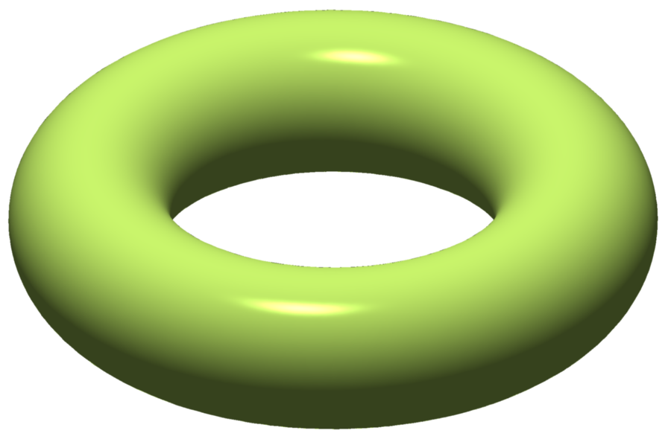

Split Signature Scattering
States are neither incoming nor outgoing but are defined at the single component of null infinity
Celestial Torus
Alexander Atanasov, Adam Ball, Walker Melton, Ana-Maria Raclariu, Andrew Strominger
2101.09591
Notes:
No Lorentz invariant notion of incoming or outgoing since there exist Lorentz transformations in 2,2 which flip the sign of the momenta.
We have a scattering vector of states.

Slide 9


(2,2) Little Group
Spinors and are real and independent.
Little group in (2,2) is
States are labelled by a continuous helicity J labelling reps of and a discrete parameter s=0,1 labelling even and odd states under the action of
Notes:
In 2,2 spinors are real and independent.
In general we analytically continue states from 1,3 such that they have half integer helicity and the discrete even or oddness is not independent.

Slide 10
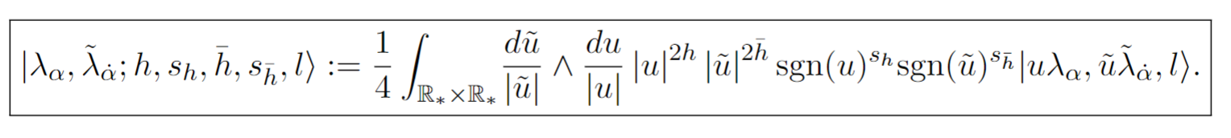

(2,2) Extended Little Group
Boosts may flip the sign of the momenta so Extended Little Group action is
Each spinor acts as a homogeneous coordinate on one of the null circles of the Lorentzian celestial torus.
States/amplitudes are labelled by reps of the extended little group and are homogeneous functions
Notes:
Again we label states and amplitudes by representations of the extended little group. We have weights h, \hb which are continuous and label reps of the factors of R+ and we have binary weights sh =0,1 which label reps of Z2. and denote even or odd symmetry under flip the sign of each spinor.
Worth pausing here to note the qualitive differences and similarities of 1,3 and 2,2. In 1,3 we have a single spinor which has an overall phase and modulus part, one can imagine actual that in complexified spacetime we would have two such spinors and so we would have two continuous and 2 half integer weights. The 2,2 slice then makes both spinors real and the continuous parameters delta and J survive but the U(1) factors degenerate into Z2 factors and these are labelled by binary weights.

Slide 11
(2,2) Chiral Mellin Transform
To build conformal primaries/correlators in homogeneous coordinates we use a (2,2) chiral Mellin transform
Mod functions and sgn functions!
Simply a product of independent Mellin transforms.
Brown, JG, Spence
2212.01327
Notes:
Define a new 2,2 chiral Mellin transform which integrates over R star, this can be thought of as two independent (half )Mellin transforms over the R star scale of each spinor.
The integration can be broken up into a Mellin transform over R plus and a sum over positive/negative energy parameters.

Slide 12
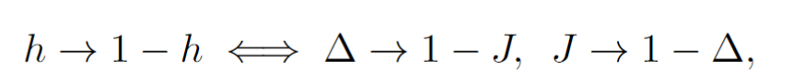
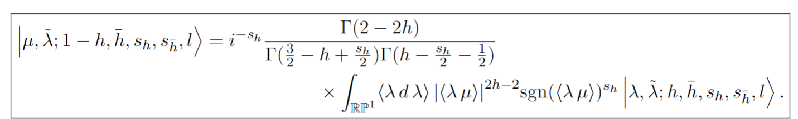
Light Transforms
Map
Light transform
Brown, JG, Spence
2212.01327
Notes:
Light transform is self inverse with this normalisation.
Also note the new formula which is adapted to the particular extended little group of 2,2 with its Z2 weights.
The light transform changes h to 1-h but does not change sh, it can only intertwine equivalent representations but the odd and even reps of Z2 are not equivalent.
Cannot antisymetrise a symmetric function.

Slide 13
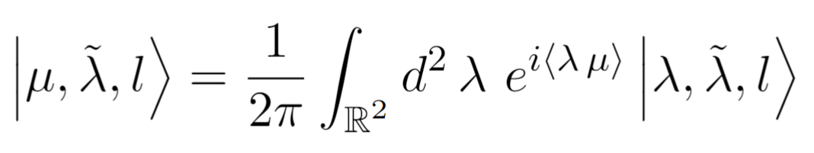
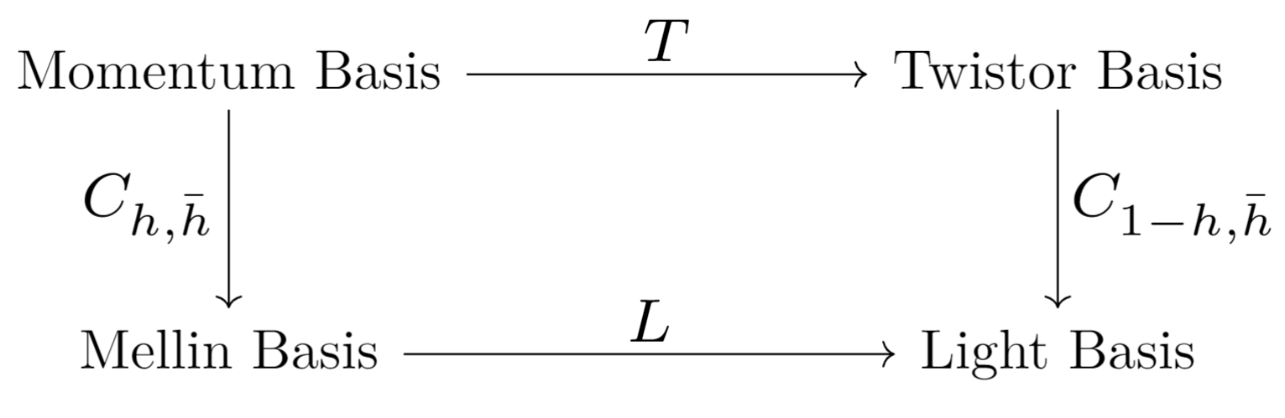
Twistor ~ Light
Witten
hep-th/0312171
Half-Fourier Transform
Sharma
2107.06250
Brown, JG, Spence
2212.01327
Notes:
Now defining the half Fourier transform in the usual way we find a commuting diagram, first noticed by sharma and which we have refined such that a light and twistor transform are directly equivalent.
Note we have used a different convention to the usual, labelling twistor conjugate of lambda by mu.

Slide 14
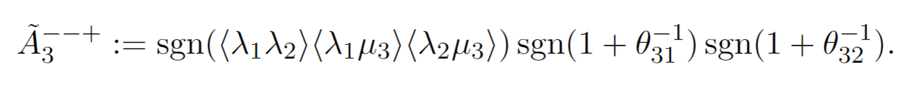
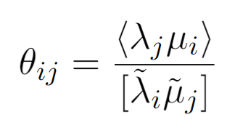
Ambidextrous Twistor Amplitudes
Arkani-Hamed, Cachazo,
Cheung, Kaplan
0903.2110
Incredibly simple!
Three Points Yang-Mills
Three Points Gravity
Nice double copy-esque structure!
Notes:
Yang Mills amplitude is a piecewise constant function taking values given by -1 or 1 and the boundaries of the regions are controlled by ratios of angle and square brackets.

Slide 15
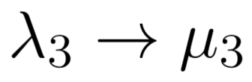
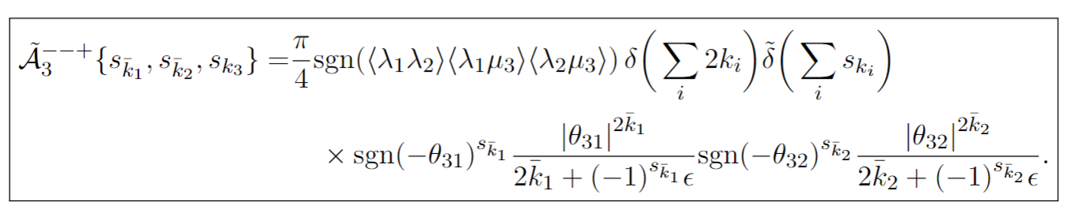
3 point MHV Ambidextrous Celestial Twistor Amplitudes
Example: Plus Helicity Leg 3
Apply Dual Twistor transform
Apply half Mellin transform over
Two steps:
(anti)symmetrise over
And integrate over positive scale of
Homogeneity
Homogeneity
Notes:
Yang Mills amplitude is a piecewise constant function taking values given by -1 or 1 and the boundaries of the regions are controlled by ratios of angle and square brackets.

Slide 16
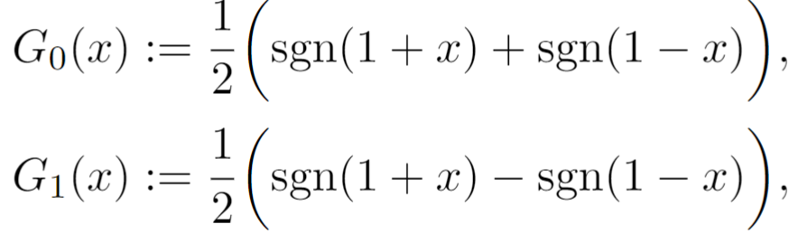
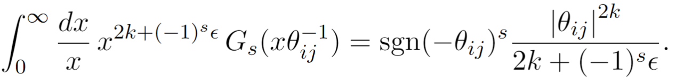
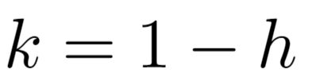
Key Integral at 3 points:
Mellin transform of an (anti)symmetrised sgn function
Notes:
Yang Mills amplitude is a piecewise constant function taking values given by -1 or 1 and the boundaries of the regions are controlled by ratios of angle and square brackets.

Slide 17
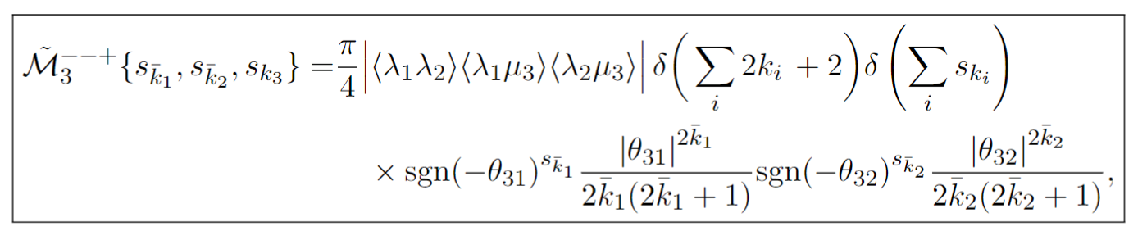
Three Point MHV
Yang Mills
Gravity
Notes:
Structure completely fixed apart from poles in weights.
Epsilons important only to prescribe the contour required to invert the Mellin transforms and recover the original amplitude otherwise they can be dropped knowing that such a contour exists.
Gravity amplitude has different mass dimension due to kappa carrying mass dimension so the delta function is altered, poles are also doubled would be interesting to understand this from a double copy perspective.

Slide 18
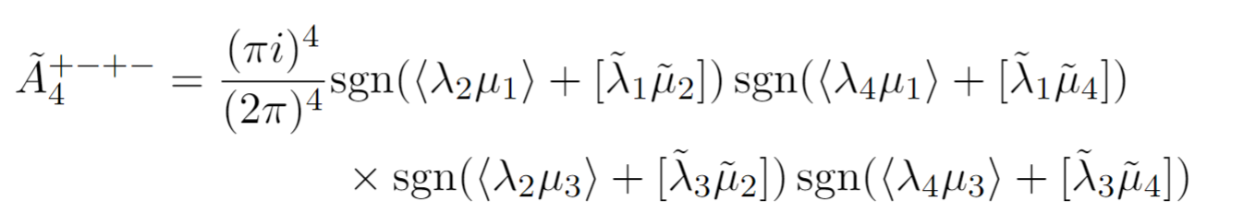
Four Point YM Twistor Amplitude
Twistor amplitude remains simple even at four points.
For Yang Mills,
Arkani-Hamed, Cachazo,
Cheung, Kaplan
0903.2110
Notes:
We run the same method.
Now we have entangled variables, each mu appears twice so we are going to have to Mellin transform products of sgn functions. More combinatoric contributions due to more complicated piecewise function. Integrals are still essentially trivial.

Slide 19
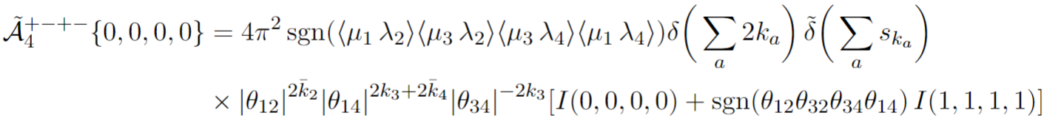
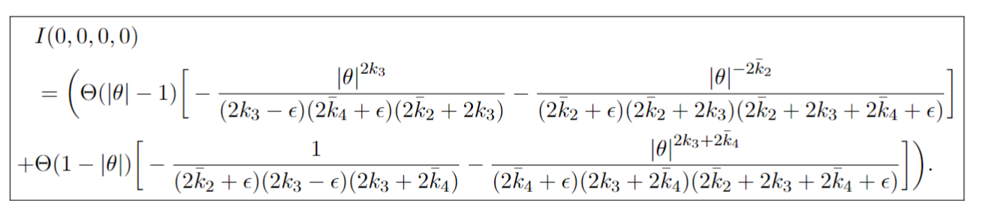
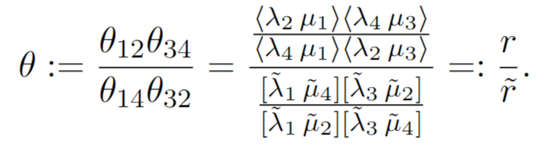
Four-Point YM Celestial Twistor Amp
Notes:
Four point celestial twistor amplitude is surprisingly simple
Structure in first line fixed by 2,2 conformal covariance.
the I functions are just a function of theta which is ratio of two real independent conformal cross ratios on celestial torus, the fact that we can write everything in terms of their ratio is a remnant of the four point momentum conservation which in momentum space fixes the two cross ratios to be equal
I functions are determined by BCFW and three points in a simply manner

Slide 20
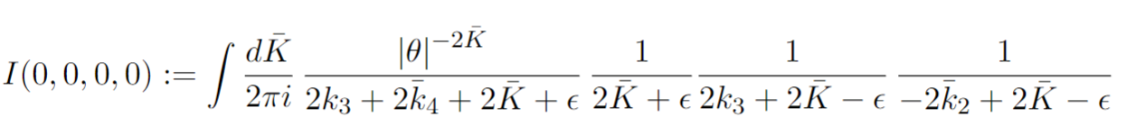
Celestial Twistor BCFW
Arkani-Hamed, Cachazo,
Cheung, Kaplan
0903.2110
Twistor BCFW recursion relations imply recursion relations for light transformed correlators on celestial torus, this gives a path to higher multiplicity correlators.
Checked four point expression and nicely explains the conformally invariant functions
Massless BCFW = multi-collinear factorisation and so contains OPE data!
Notes:
Expression is straightforward but would take a while to explain, however would like to note that has been used to check the four point expression.
BCFW on celestial torus involves gluing two legs of three point amplitudes which involves integrating over the weights, which localises on the poles of the two three point amps of which there are four, this gives four terms in four point amp and one contour integral means we have 3 poles remaining as per I functions. The direction we close the contour is controlled by magnitude of theta.

Slide 21
Outlook
Road to higher multiplicity is clear but not easy
Ready to extract Lorentzian CCFT data via conformal block decomposition/partial waves
How exactly is this related to BCFW?
Supersymmetric extensions are well known in twistor space and give corresponding extensions of the formulae presented here, including celestial supertwistor BCFW.
Are light/twistor celestial correlators THE basis for CCFT?

