Slide 1
Deep Learning in CLOUD: Event Reconstruction in an Opaque Scintillator
Garrett Wendel
gmw5164@psu.edu, Penn State University
June 27th, 2024
NPML 2024

Slide 2
Outline
1. ML & Event Reconstruction
2. LiquidO & CLOUD
3. ML Technique
4. Applications

Slide 3
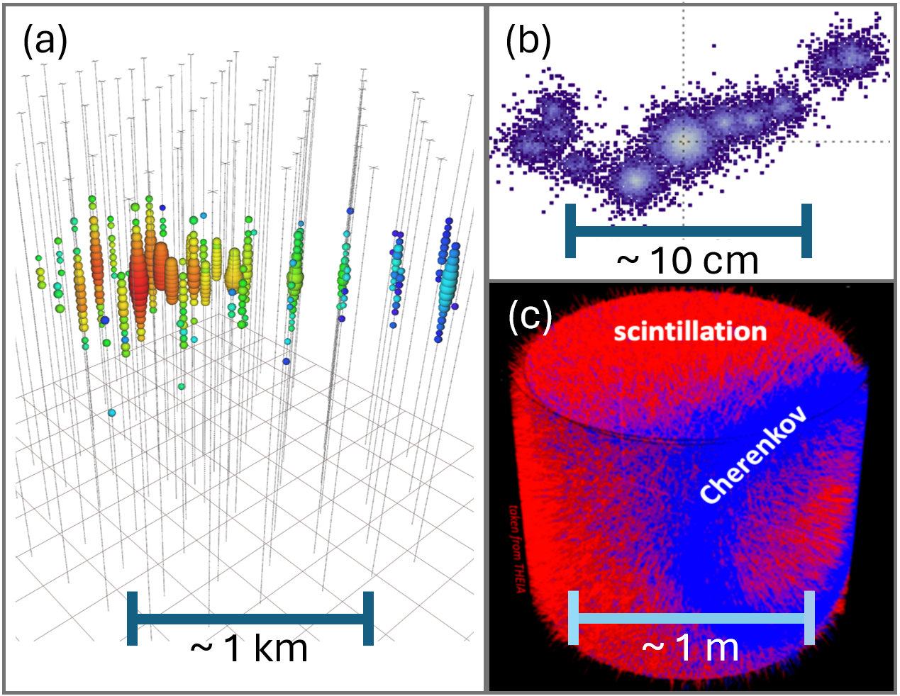
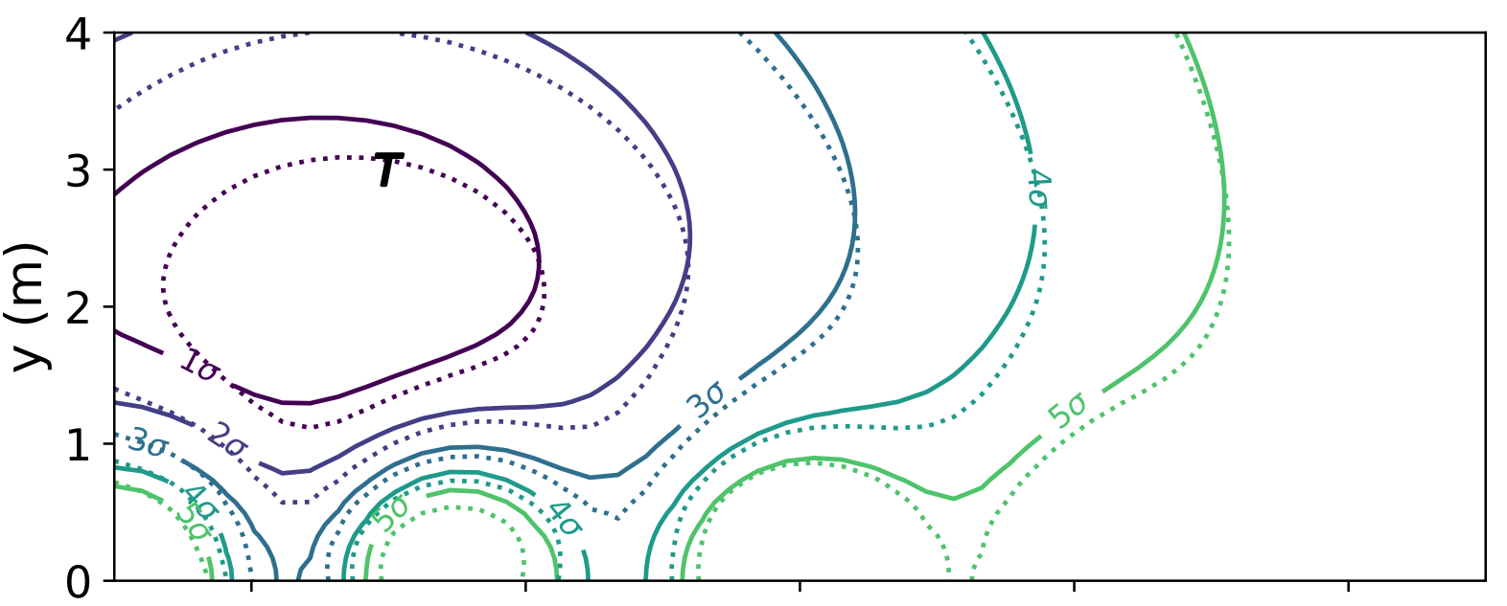
ML Challenges in Neutrino Physics
Geometry:
Confidence:
T Source position
Analytic LLH
Network LLH
Sensors
T
T
~20 cm
log-likelihood (LLH) contours for a single particle event with no binning
Particle event displays for
(a)IceCube (b) LiquidO (c) Eos/Theia

Slide 4
Event Reconstruction
Hypothesis $θ$:
Particle type & kinematics
[PID, q, p]
Observation $X$:
Detector readout
[many photons]
$$β^{−}$$
$$β^{−}$$

Slide 5
Event Reconstruction
Markov Chain Monte Carlo Simulation
Hypothesis $θ$:
Particle type & kinematics
[PID, q, p]
Observation $X$:
Detector readout
[many photons]
$$β^{−}$$
$$β^{−}$$

Slide 6
Event Reconstruction
Markov Chain Monte Carlo Simulation
Hypothesis $θ$:
Particle type & kinematics
[PID, q, p]
Observation $X$:
Detector readout
[many photons]
$$β^{−}$$
$$β^{−}$$
ML Techniques?

Slide 7
Outline
1. ML & Event Reconstruction
2. LiquidO & CLOUD
3. ML Technique
4. Applications

Slide 8
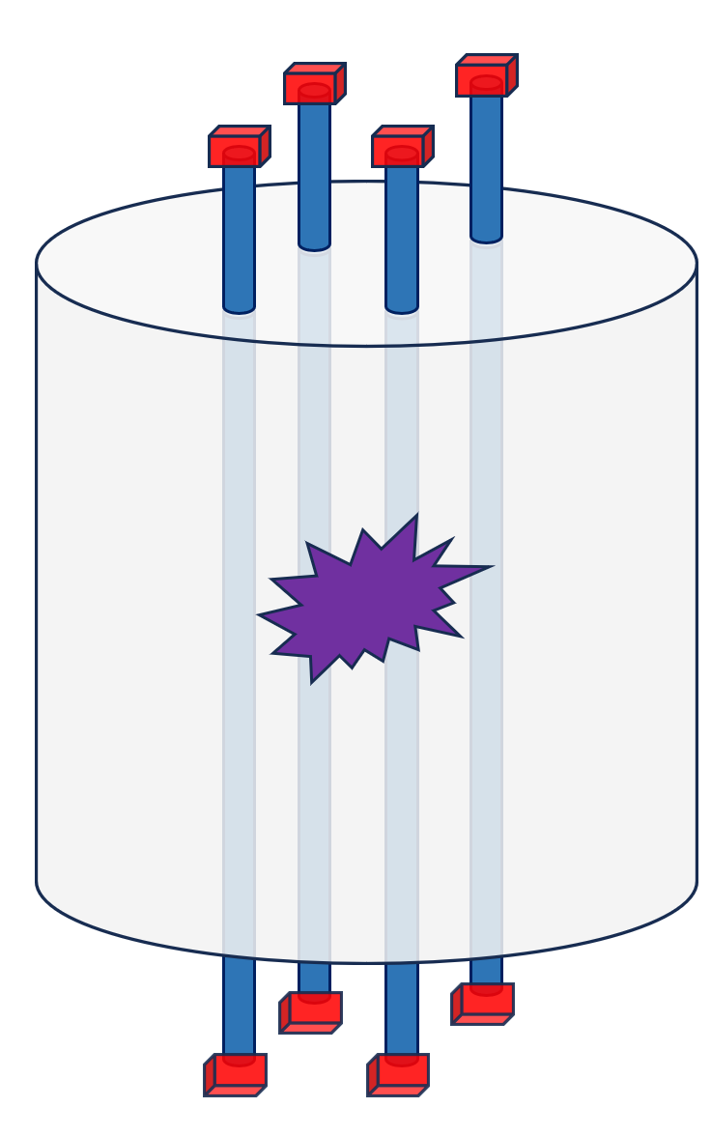
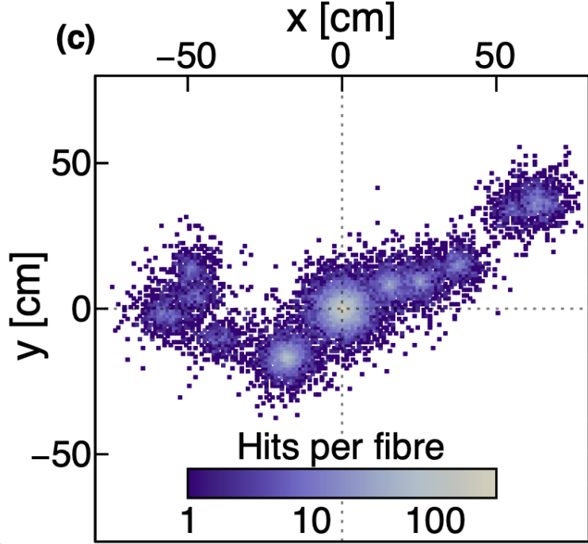
Observations in LiquidO
Particle tracking with an opaque scintillator and wavelength shifting fibers
SiPM
$$β^{+} \& 2γ$$
$$β^{−}$$
Wavelength Shifting Fiber
~10 cm
Scattering Scintillator
$$γ$$
Scintillation Light
Photons absorbed in Fiber
LiquidO event display for MeV scale particle interactions

Slide 9
Photon Dynamics
1) Photon produced by incident particle scatters until absorption.

Slide 10
Photon Dynamics
1) Photon produced by incident particle scatters until absorption.
2) Photons absorbed by wavelength shifting re-emitted isotropically in fiber
Capture

Slide 11
Photon Dynamics
1) Photon produced by incident particle scatters until absorption.
2) Photons absorbed by wavelength shifting re-emitted isotropically in fiber
3) Photons captured propagate to photosensor

Slide 12
Simulated Observation
$$β^{−}$$
Event observations, $X$, highlighting spatial and timing information
$$γ$$

Slide 13
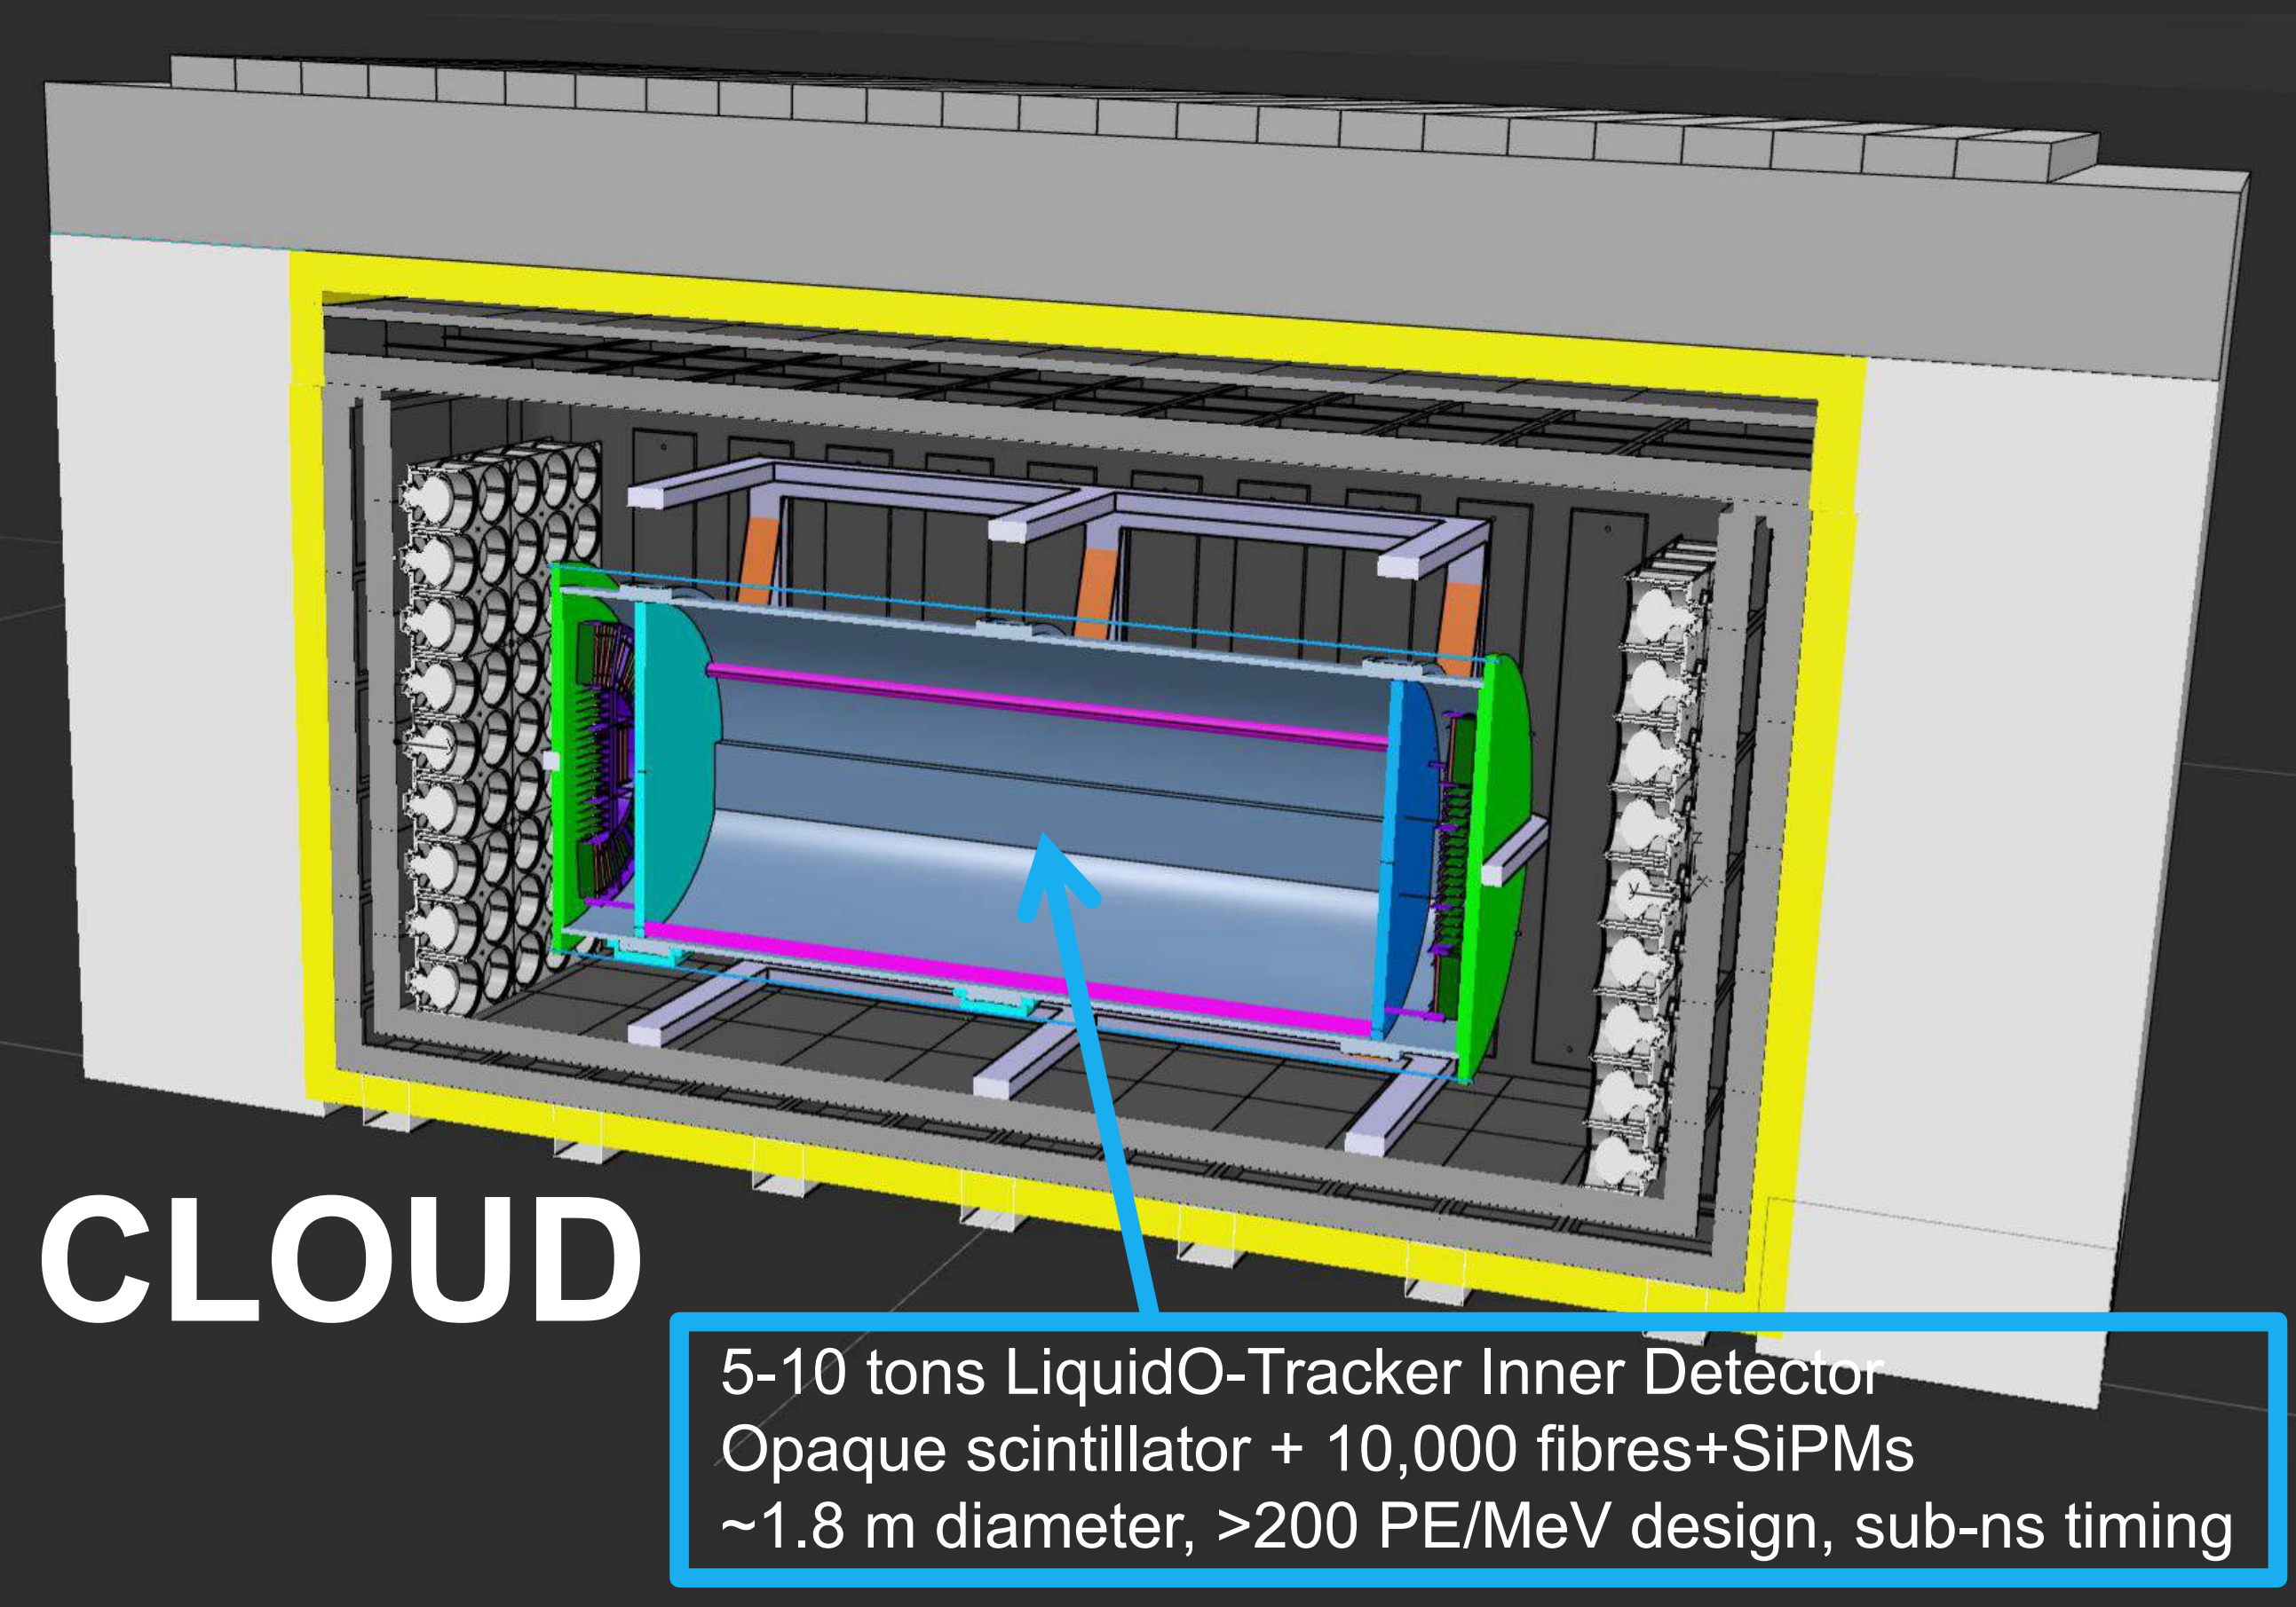
Chooz LiquidO Ultranear Detector (CLOUD)
Demonstrate above ground reactor ${\overline{ν}}_{e}$ measurement with LiquidO technology
35m offset from Chooz-B
Measure reactor power with ~10k ${\overline{ν}}_{e}$ interactions per day
Additional physics goals:
Solar pp neutrinos (¹¹⁵In)
Geoneutrinos (Cu)
(J. Hartnell)
zenodo.org/records/11444562

Slide 14
Outline
1. ML & Event Reconstruction
2. LiquidO & CLOUD
3. ML Technique
4. Applications

Slide 15
ML Technique for Reconstruction
Geometry with Likelihoods
Confidence with Neural Ratio Estimators:
T Source position
Analytic LLH
Network LLH
Sensors
T
T
~20 cm
log-likelihood (LLH) contours for a single particle event with no binning
Particle event displays for
(a)IceCube (b) LiquidO (c) Eos/Theia

Slide 16
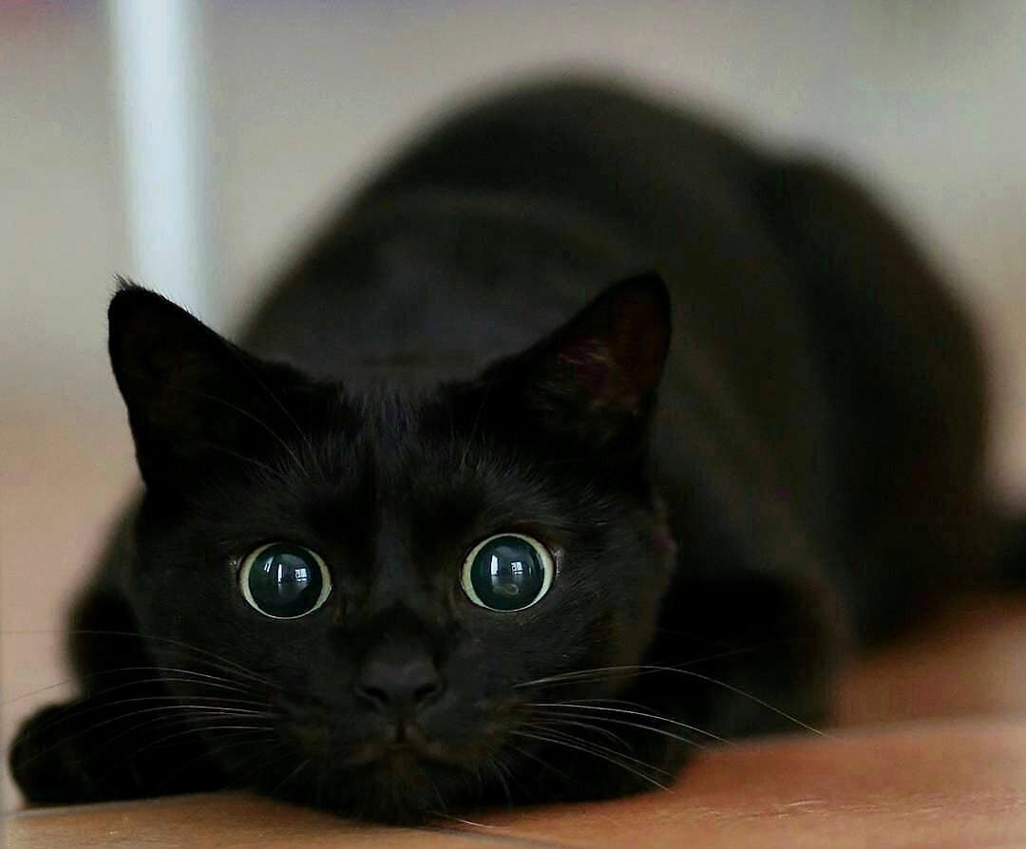
Teaching an Old Classifier New Tricks
Binary Classification: a well studied problem with powerful tools
Neural Ratio Estimators (NREs) generate likelihood functions using the same methodology, but classes are correlated and uncorrelated $(X,θ)$ pairs
(Similar method to hypothesis testing in Andre’s talk)
Neural Network
Dog or Cat?

Slide 17
Teaching an Old Classifier New Tricks
Correlated
Uncorrelated
Binary Classification: a well studied problem with powerful tools
Neural Ratio Estimators (NREs) generate likelihood functions using the same methodology, but classes are correlated and uncorrelated $(X,θ)$ pairs
$θ:$ Moving Down
$X:$
$θ:$ Moving Right
$X:$
Neural Network
Correlated or Uncorrelated?

Slide 18
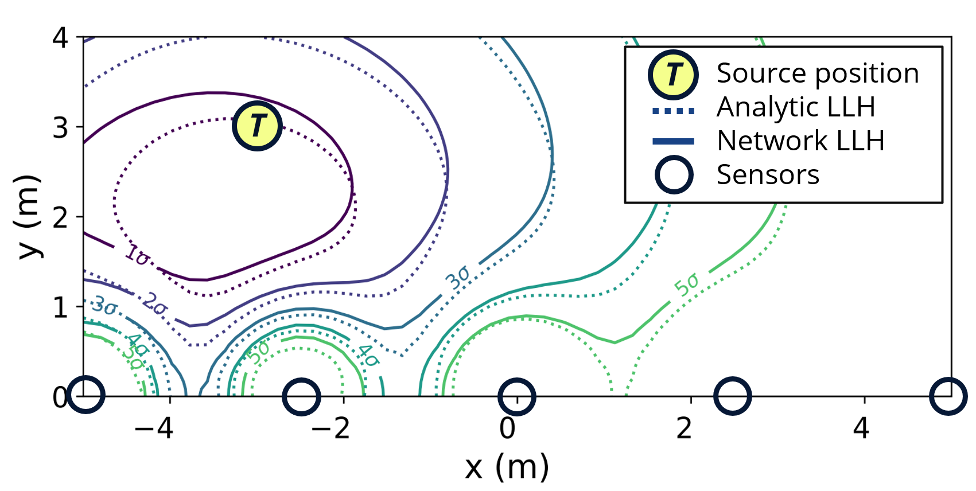
Procedure for Neural Ratio Estimators
1) Generate two datasets from simulation
Correlated: Simulation output
Uncorrelated: Shuffle Correlated data
2) Train a network to classify the data using standard crossentropy loss
3) Resulting network is the likelihood to evidence ratio
Correlated: Uncorrelated:
$\left(X_{1},θ_{1}\right)→1$ $\left(X_{1},θ_{3}\right)→0$
$\left(X_{2},θ_{2}\right)→1$ $\left(X_{3},θ_{2}\right)→0$
$\left(X_{3},θ_{3}\right)→1$ $\left(X_{2},θ_{3}\right)→0$
Trained network $d^{∗}: \frac{d^{∗}}{1−d^{∗}}=\frac{p\left(X | θ\right)}{p(X)}$

Slide 19
Data Geometry and Inference Model
Standard ML paradigm:
Finding a sufficient statistic is difficult; How does one parameterize what describes a dog vs cat?
Solution: Give ML model all data simultaneously to avoid this requirement
~20 cm

Slide 20
Inference Modelling
$$x_{3}$$
$$x_{2}$$
Neutrino Physics:
We know how to parameterize our model! The state of our particle as a function of time fully describes our interaction given a ‘fixed’ detector.
$$θ$$
$$x_{1}$$
~20 cm

Slide 21
Inference Modelling
$$x_{3}$$
$$x_{2}$$
If $θ$ is a sufficient statistic, we can break our time series data into independent measurements
Instead of giving a neural network all photons simultaneously, we can evaluate individual photons $i$ for each sensor $s$ using Extended Maximum Likelihood
$$θ$$
$$x_{1}$$
~20 cm

Slide 22
Extended Maximum Likelihood (EML)
By decomposing the likelihood our network input becomes:
$x_{s,i}=$ [Sensor ID, Time of Arrival] Single Photon information ~Dim 2
$θ =$[Particle kinematics] ~Dim 7
Total input ~ Dim 10 regardless of geometry and number of photons
Decomposition provides:
Input independent from geometry and measurement sample size
Symmetry: e.g. detector time translation invariance is simply $t_{x}−t_{θ}$
Efficient training: We don’t need to spend time learning data representation
Small networks: ~Dim 10 input is easily handled by simple MLP

Slide 23
HITMAN: Event Reconstruction Software
Highly-parallelizable Inference Technique for Monitoring Anti-Neutrinos
(Based on work originally performed for WATCHMAN collaboration)
Software implementation of NRE + EML for inference
Avoids “hand-tuning” of algorithms
Detailed methodology by Eller, et al. [1]
Ethos: “If you can simulate it, we can reconstruct it”
[1] 10.1016/j.nima.2023.168011

Slide 24
Outline
1. ML & Event Reconstruction
2. LiquidO & CLOUD
3. ML Technique
4. Applications

Slide 25
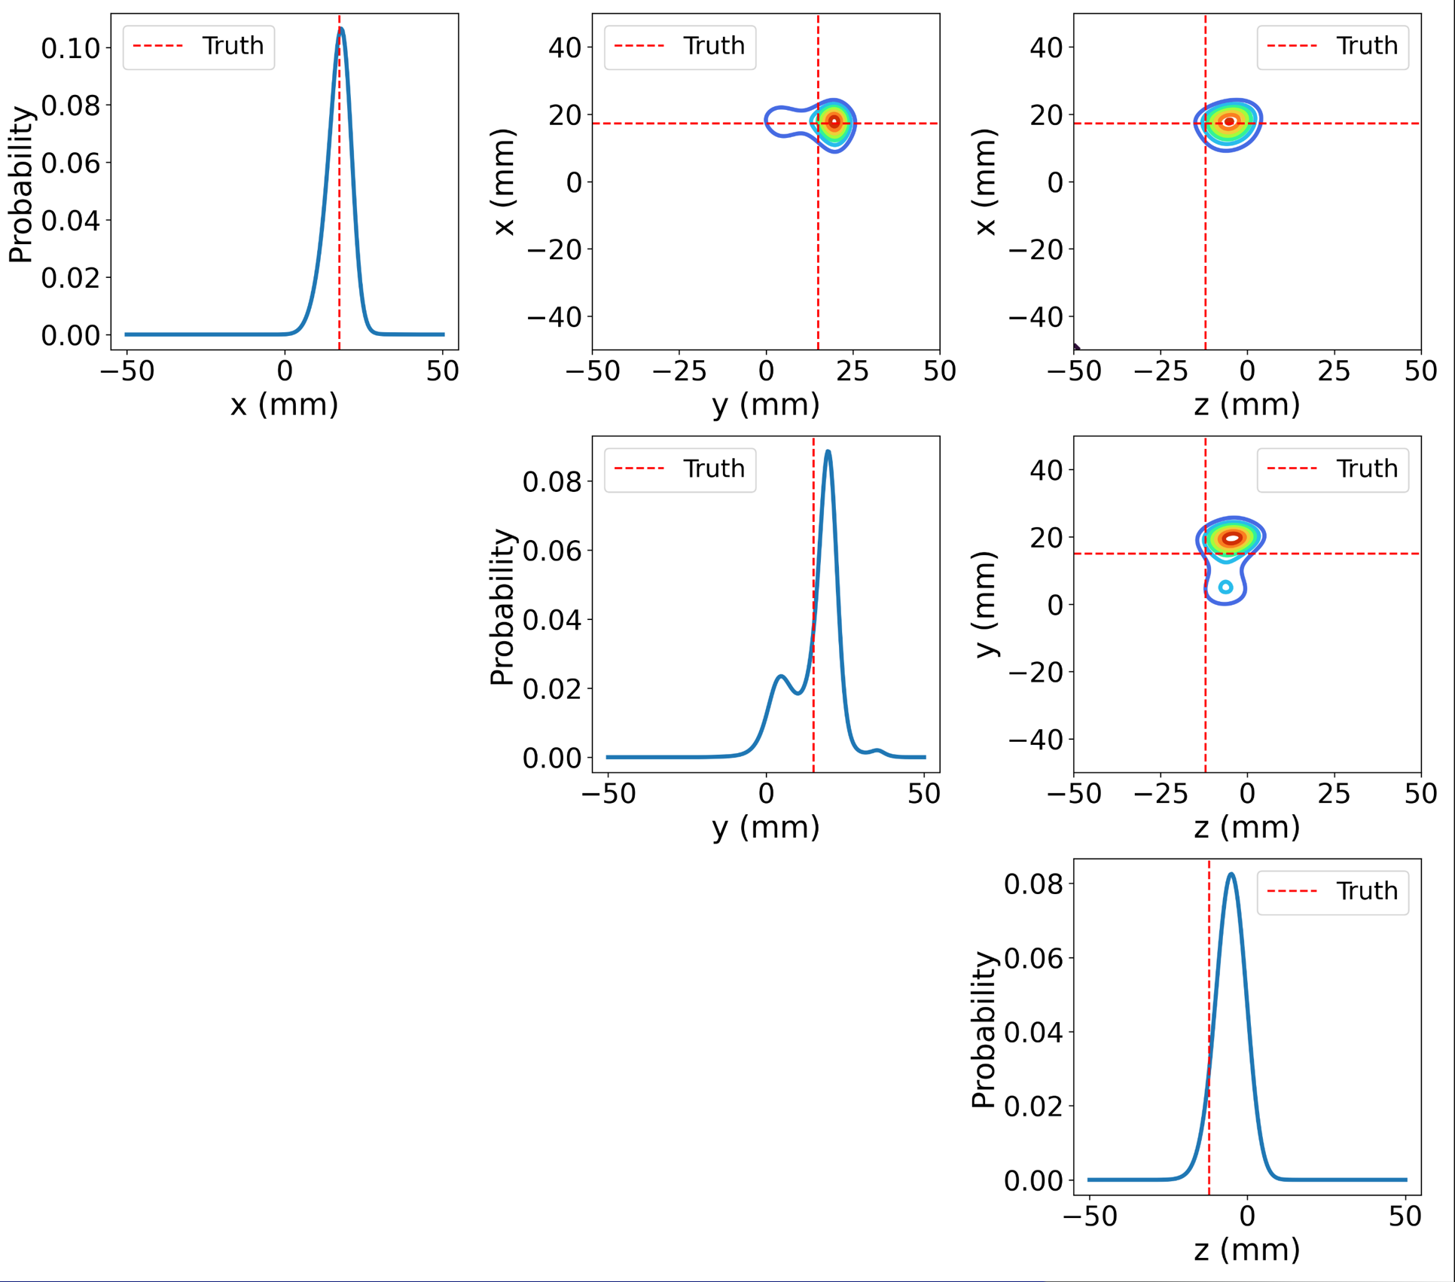
Event reconstruction in CLOUD
$θ:$ Event position
Hypothesis
$X:$
HITMAN
$$β^{−}$$

Slide 26
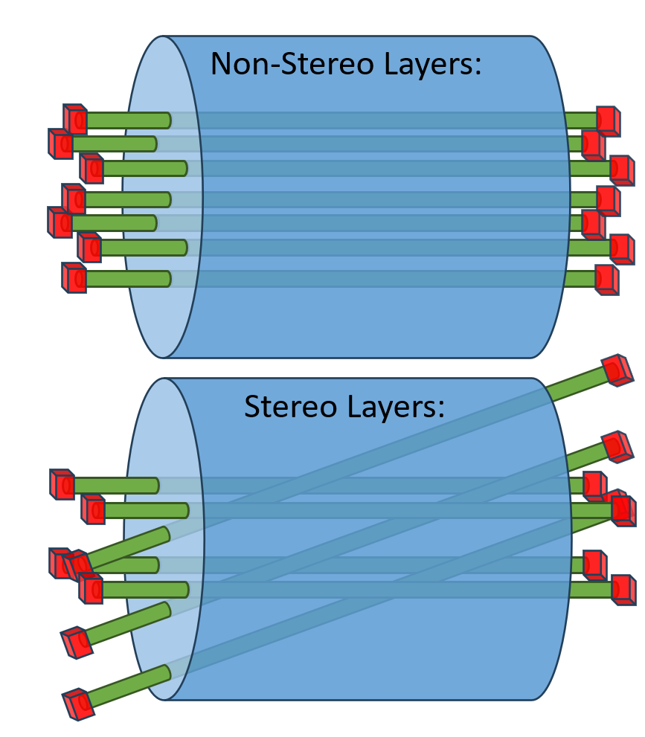
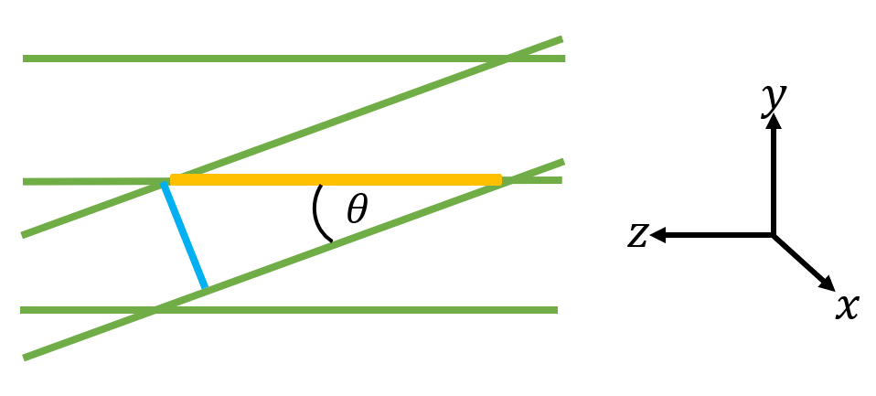
Quantifying Detector Performance
Use HITMAN to reconstruct events in two different geometry configurations:
Non-stereo layers, only timing information about z
Alternating stereo layers (20° tilt), timing and spatial information for z
Expectation for Stereo z Resolution:
∝1/sin($θ_{tilt}$)

Slide 27
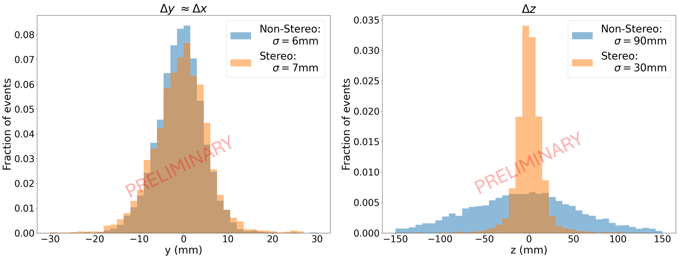
Reconstruction Results
The histograms compare vertex resolution, $σ≡$ MSE, for non-stereo (blue) and stereo (orange) setups using conservative estimates when simulating detector performance. The left shows xy-plane resolution, and the right shows z-axis resolution.

Slide 28
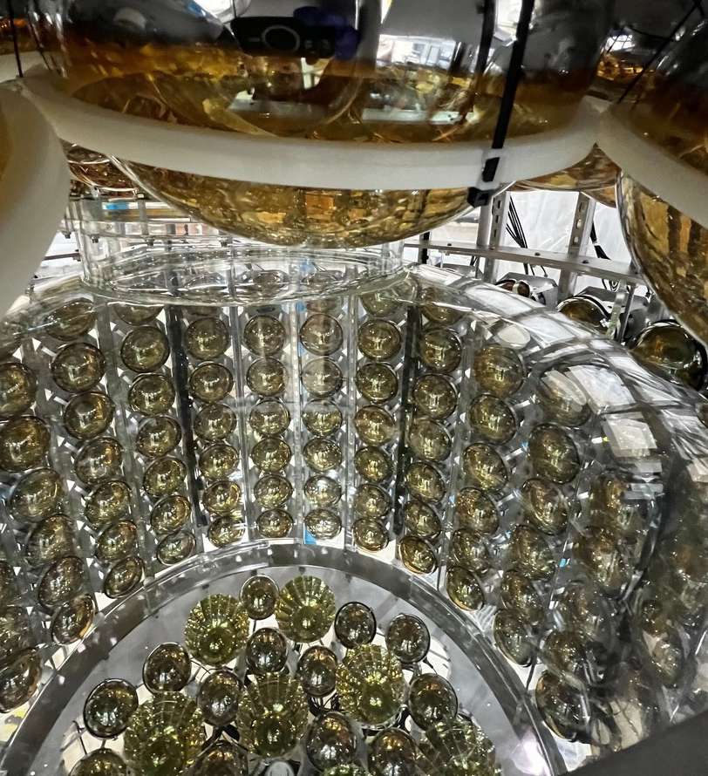
Additional Applications: Eos
Hybrid Water Cherenkov & Scintillation detector
See NPML2023 Talk
First light recently seen, reconstructions on real data underway

Slide 29
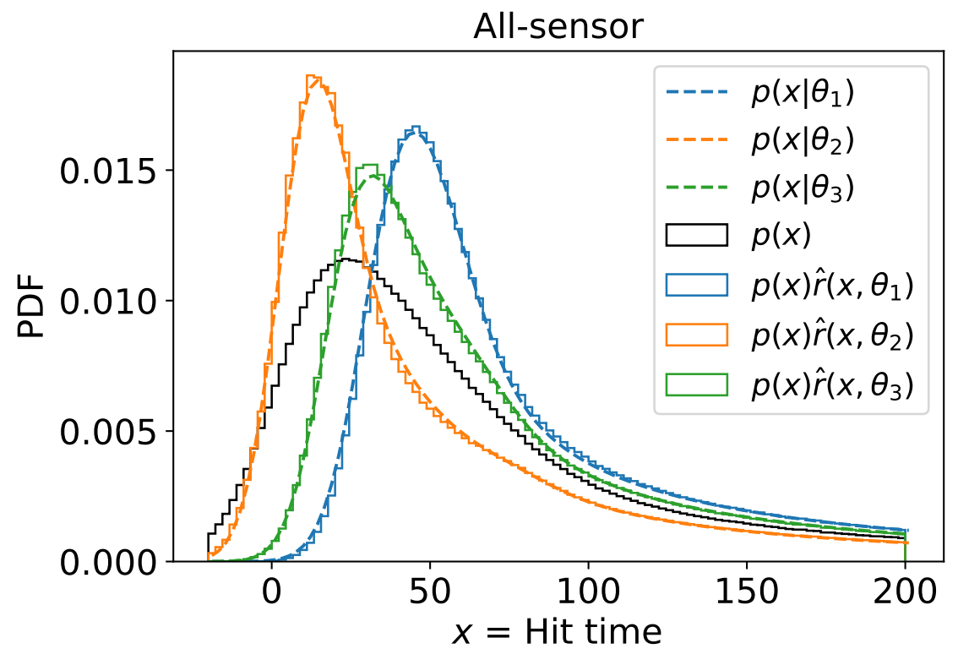
Network Validation & Event Generation
Since we have full likelihood, we can generate events by fixing $θ$ and sampling from $p(X|θ)$ provided by network:
We can also perform KS tests to get agreement between
MC results
Neural Network Fit
Known Calibration Data

Slide 30
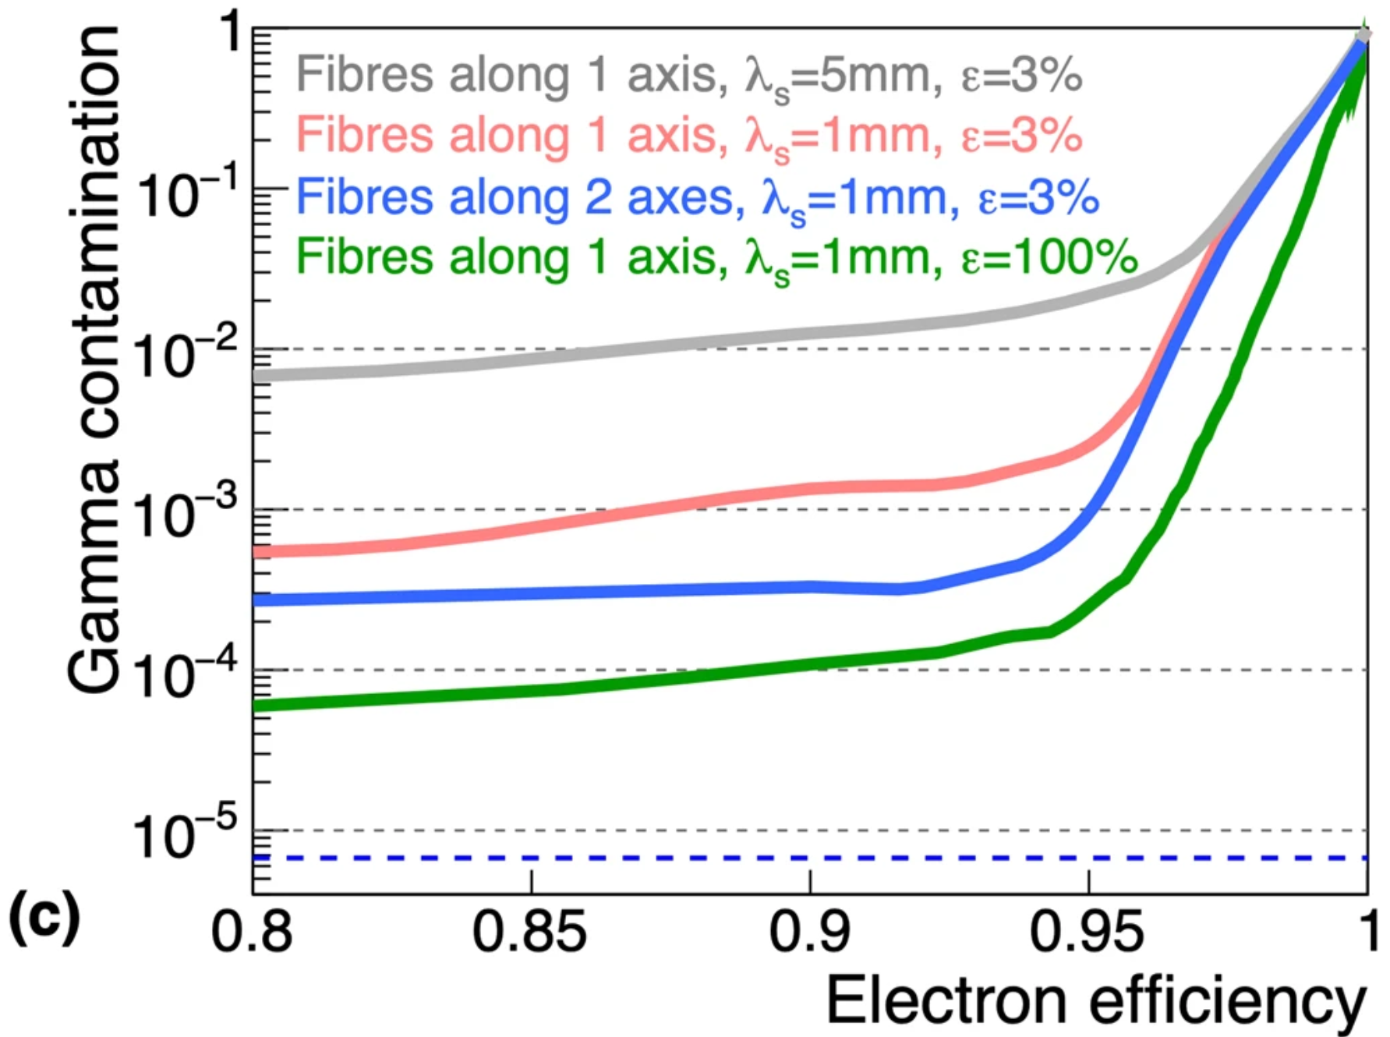
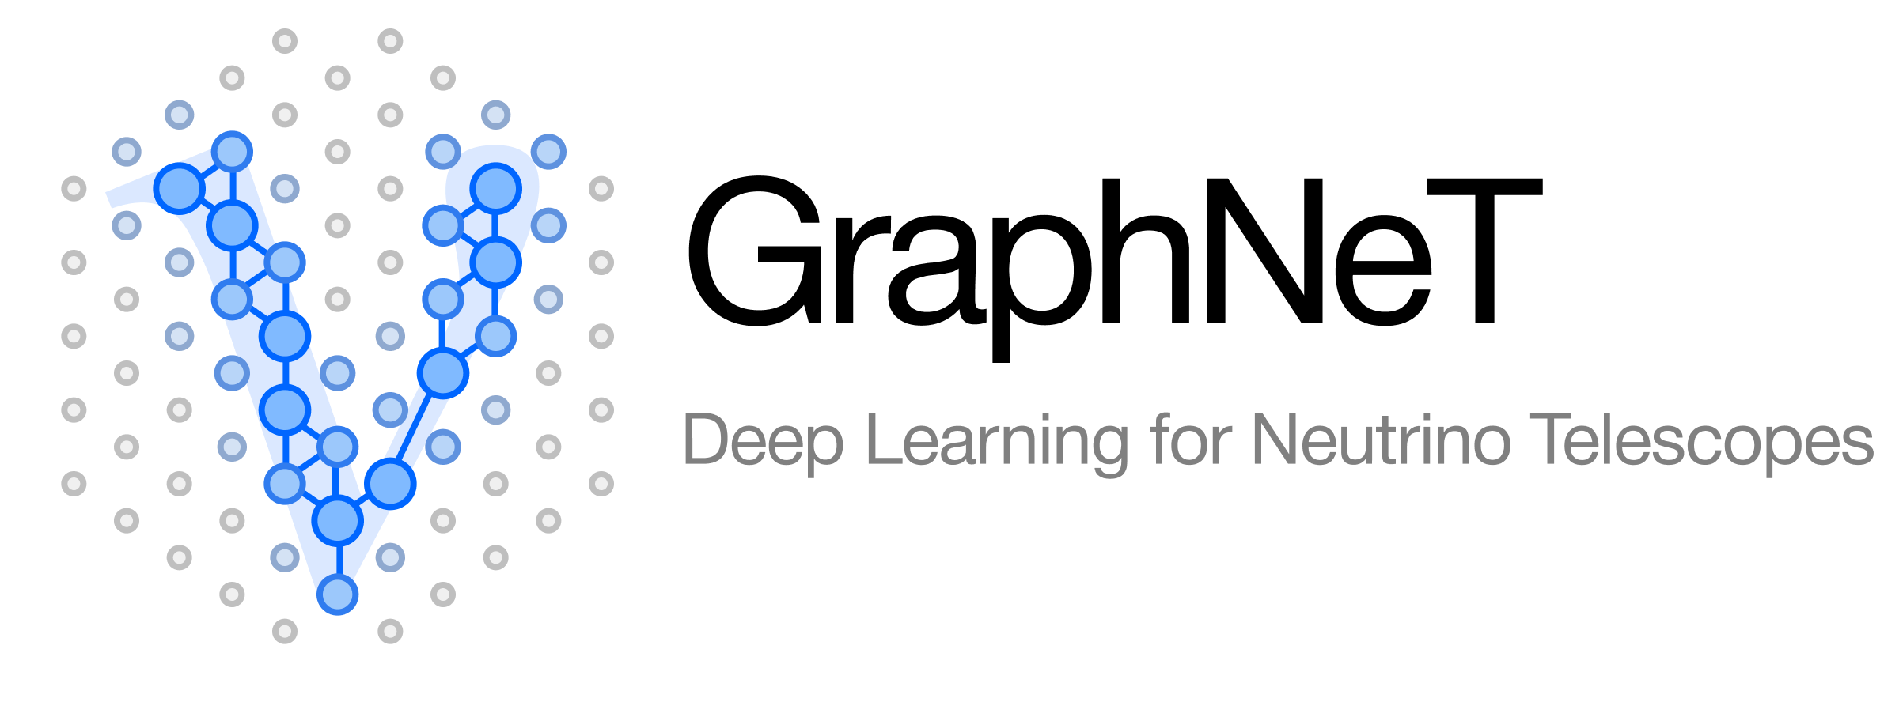
Future Work
$$x_{3}$$
$$x_{2}$$
Implement full track reconstruction:
Incorporate particle Identification
Compare network performance with alternative reconstruction methods
$$θ$$

Slide 31
Backup Slides

Slide 32
Neural Ratio Estimator; Theory
1) Generate two sets of data:
Set 1 is a joint distribution describing correlated events $p_{1}=p\left(x,θ\right)$
Set 2 is a product of the marginal probabilities $p_{2}=p\left(x\right)p\left(θ\right)$ describing uncorrelated events
2) Define a classification function $\{d\left(x,θ\right)|0≤d\left(x,θ\right)≤1\}$ that describes the likelihood $(x,θ)$ are correlated (from Set 1). Thus:
$q_{1}=d\left(x,θ\right)$ the probability $(x,θ)$ is from Set 1
$q_{2}=1−d(x,θ)$ the probability $(x,θ)$ is from Set 2
3) Define binary cross entropy between distributions $p$ and $q$: $H\left(p,q\right)=−\sum_{i}{p_{i}ln(q_{i})}$
$H=−p_{1}ln(d(x,θ))−p_{2}ln(1−d(x,θ))$
4) Find a $d^{∗}(x,θ)$ such that it satisfies ${\left.\frac{δH}{δ\left(d\left(x,θ\right)\right)}\right|}_{d^{∗}}=0$, implying:
$\frac{d^{∗}}{1−d^{∗}}=\frac{p(x|θ)}{p(x)}∝L\left(θ | x\right)$ (for constant x)
See Likelihood-free MCMC with Amortized Approximate Ratio Estimators (arxiv.org) for more information

Slide 33
Extended Maximum Likelihood (EML)
Typical detector response can vary over many orders of magnitude
Complicated network structures and large datasets required to ‘learn’ how to appropriately reduce input
Solution: decompose likelihood into a constant length terms encoding (EML)
With access to full likelihood from the neural ratio estimator, we can decompose the detector response into independent components

Slide 34
Extended Maximum Likelihood
Assume each detector is comprised of infinitesimally small tiles ($δA$) such that it only sees one photon per event.
 |  |  | $$δA$$
~
Full Detector
Likelihood per infinitesimal sensor

Slide 35
Extended Maximum Likelihood
To account for finite size photosensors, integrate over area generating an additional Poisson-like term
 | A
Finite Sensor Likelihood
Poisson-Like term
Likelihood per photon

Slide 36
Extended Maximum Likelihood
Combine finite size sensors likelihoods by multiplying them together
Full Likelihood
Finite Sensor Likelihood

Slide 37
The Extended Maximum Likelihood
We rewrite the full likelihood in a less intuitive, but functionally equivalent way:
The full likelihood space is built with two densely connected networks
Chargenet: Likelihood utilizing ‘calorimetric’ information
Hitnet: Likelihood utilizing single photon information (over all $s_{i}$ photons)
Full Likelihood
Multi-sensor Info
(Chargenet)
Information per photon (Hitnet)

